Slide 1
Status and developments of the ALBA RF system
ESLS-RF meeting 2023
P. Solans on behalf of the ALBA RF group

Slide 2
Outline
Introduction
Operation
  Failures
  Incidences
Developments
  3rd harmonic cavity
  DLLRF
  1.5 GHz SSPA Transmitters
Summary

Slide 3
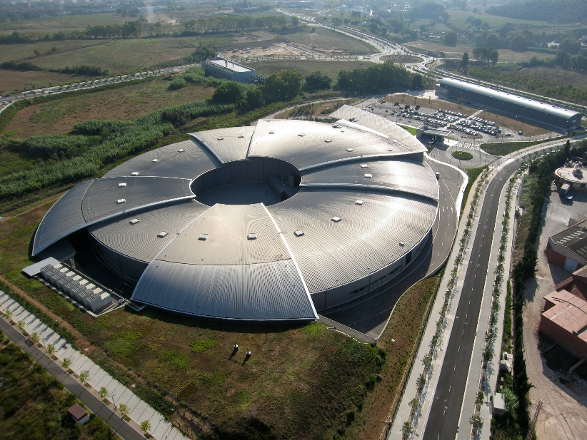
Introduction: ALBA
ALBA is a 3rd generation synchrotron light source located in Barcelona, Spain.
User operation since 2012 and currently 12 beamlines.
Upgrade towards 4th generation planned in 2030: ALBA-II
Parameter | Value | Unit
Energy | 3.0 | GeV
Current | 250 | mA
Circumference | 268.8 | m
Momentum compaction factor | 8.9E-4 | -
Loses per turn | 1.1 | MeV
Emittance | 4.5 | nm·rad

Slide 4
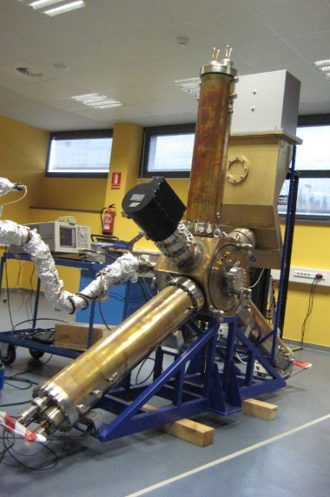
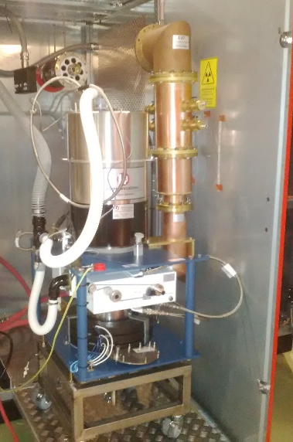
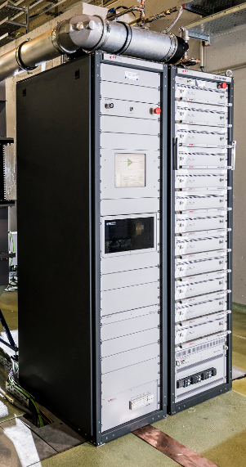
Introduction: RF system
Storage Ring: EU HOM damped cavity (500 kV) fed with IOT amplifiers (2x80 kW).
Booster: 5-cell PETRA type cavity and a SSPA (50 kW).
Parameter | Value | Unit
RF frequency | 500.0 | MHz
Number of cavities | 6 | -
Total voltage | 3.0 | MV
Cavity shunt impedance | 3.3E6 | Ohm
Unloaded quality factor | 29500 | -
Coupling factor | 2.7 | -
Beam power | 275 | kW
EU HOM damped cavity
IOT transmitter
BO SSPA

Slide 5
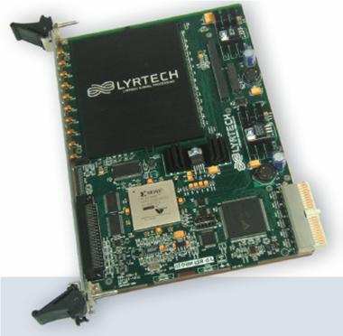
Introduction: DLLRF
ALBA DLLRF is based in the VHS-DC digital board from Lyrtech.
In house firmware: PI and tuning loops, trip compensation, cavity Autorecovery, ...
Digital board: VHS-ADC from Lyrtech
*Courtesy of Angela Salom

Slide 6
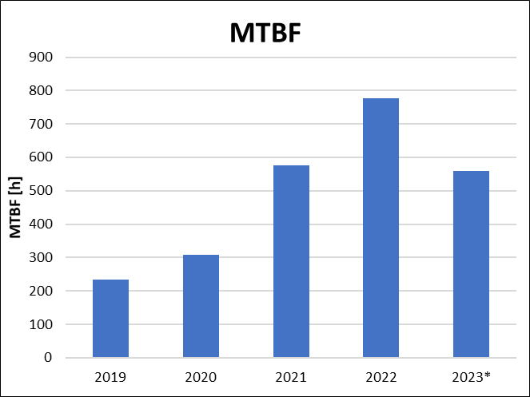
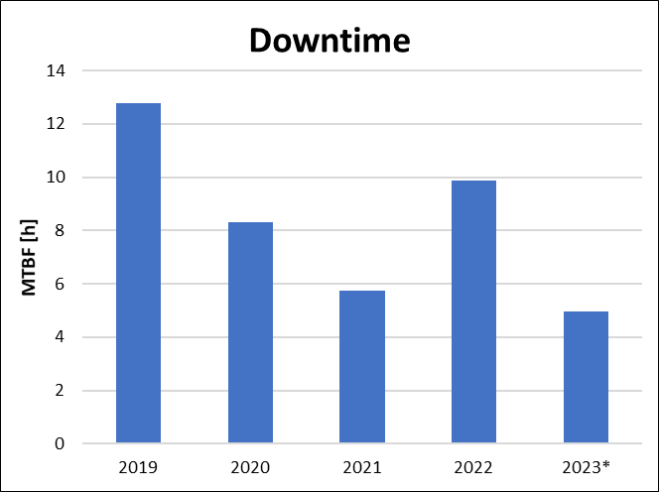
Operation: Failures
Failures: beam loss
Major failure in 2022:
  Booster DLLRF wrong configuration caused 5.49 hours of beam lost.
  Daily cron job to check the DLLRF settings.
Major failure in 2023:
  MO amplifier failure caused 1.8 hours of beam lost.
*data until 05/11/2023

Slide 7
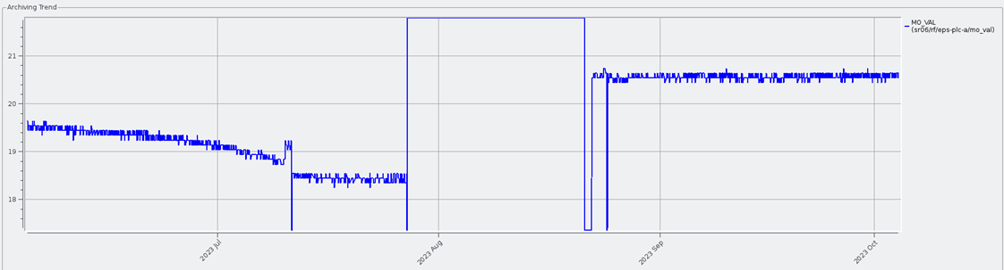
Operation: 2023 MO failure
MO signal is amplified and spread all over the facility: RF, timing, diagnostics, BLs,…
In Spring 2023 a power level drop was observed.
Amplifier replaced during maintenance day, but spare failed during operation.
Spare parts test policy improved: long term test.

Slide 8
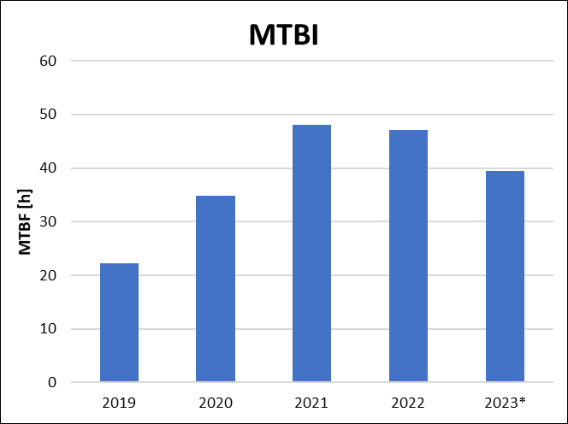
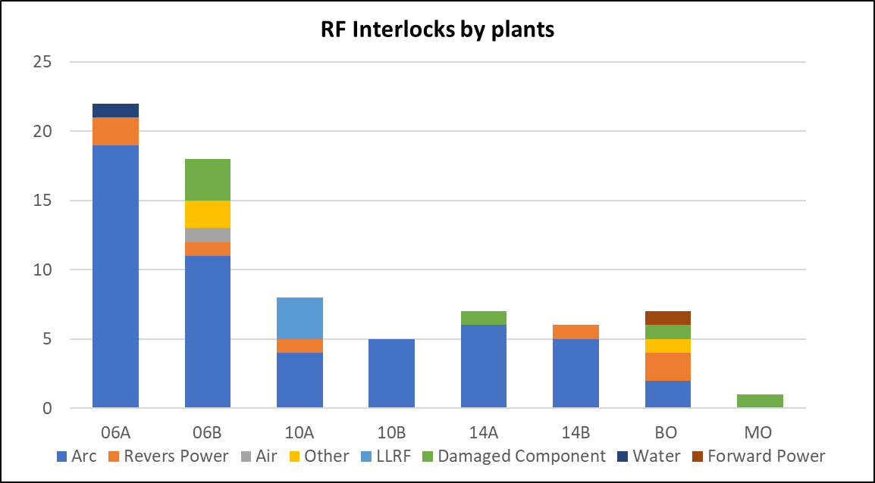
Operation: Incidences
Incidences: One cavity trip, but the beam still survives.
Major incidence contributor:
  Arcs represent 70 % of total incidences
  They can lead to beam loss due to lack of redundancy while one cavity is OFF.
*data until 05/11/2023

Slide 9
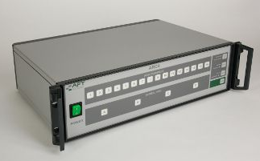
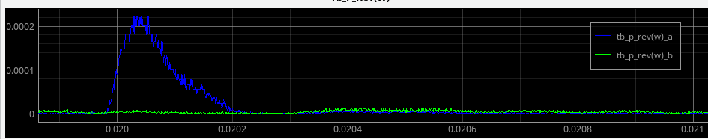
Developments: CAD
Coincidental Arc Detector (CAD) installed in one cavity.
Light is detected only in one of the channels so far.
Reason is unknown
  Scintillation
  Electrical noise
  ...
ARC4 2.0 detector
Channel 1
Channel 2

Slide 10
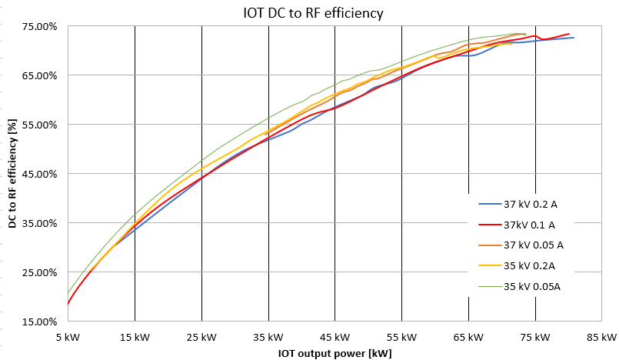
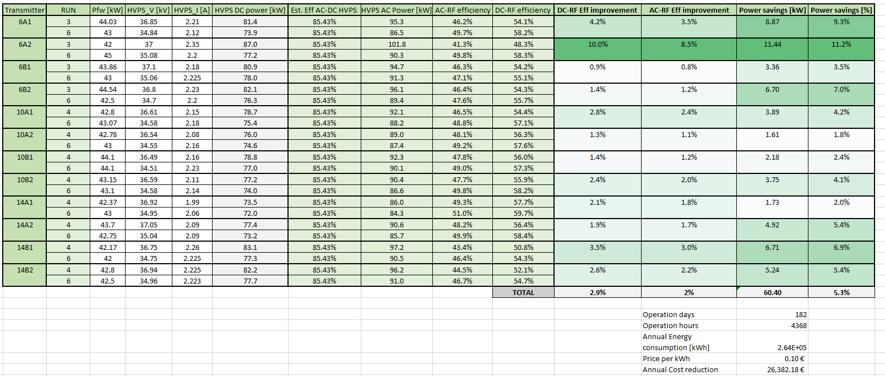
Developments: IOT efficiency improvement
IOT DC to RF efficiency improved.
  IOT maximum power is not reached during operation nor during transient.
  Cathode IOT voltage adjusted.
2024 goal: IOT output tuning and bias current adjustment.
IOT output coupling increased

Slide 11
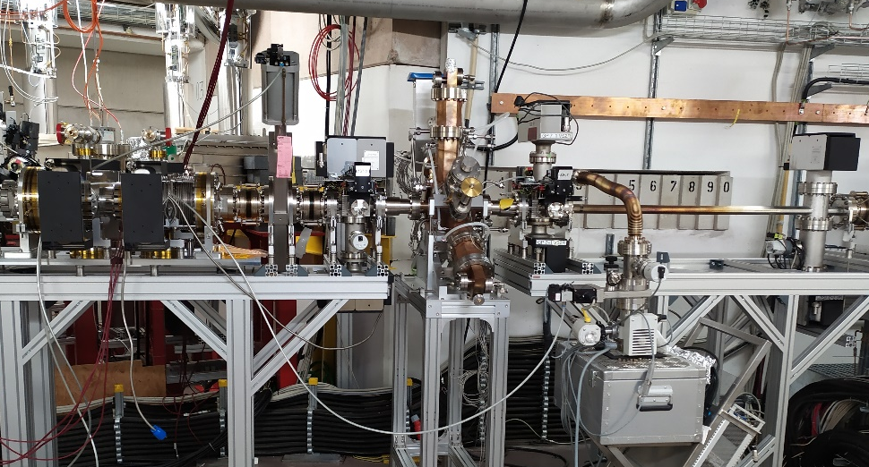
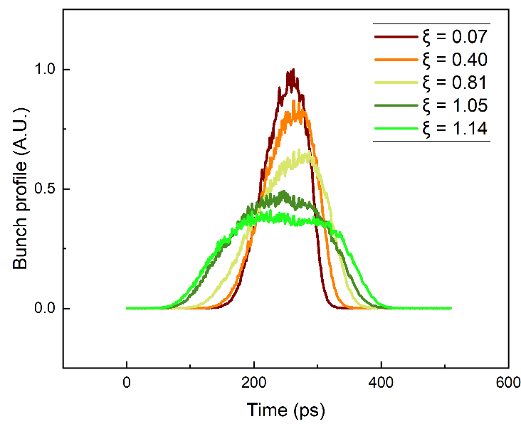
Developments: 3rd harmonic cavity
ALBA has developed an active 3rd harmonic cavity based in the EU HOM.
  ALBA 3rd Harmonic Cavity manufacturing and test collaboration, J. Ocampo, ESLS-21, DESY
Tested with DESY and HZB. Installed in August 22 in BESSY-II.
  First commissioning results of the active 1.5 GHz cavity prototype test at BESSY II, A. Maatvenko, HarmonLIP 2022

Slide 12
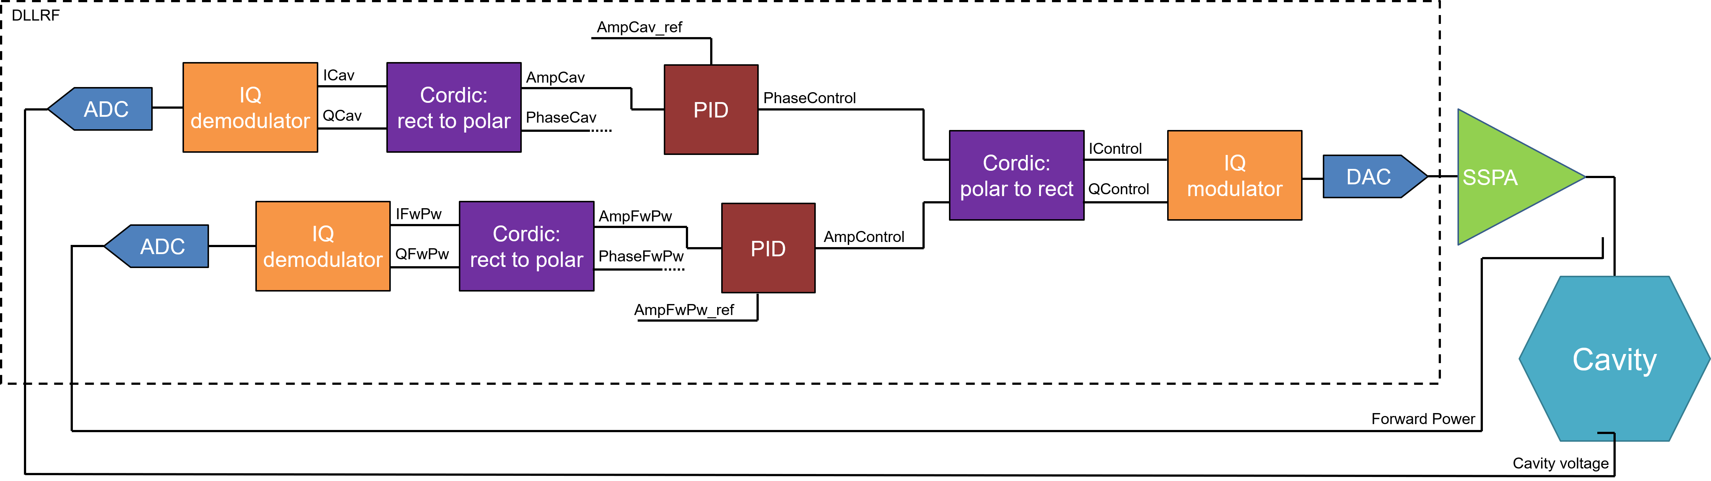
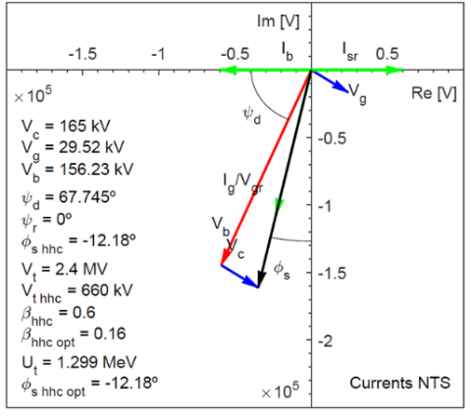
Developments: 3rd harmonic active cavity
3rd harmonic cavity for high current operation.
  Homogeneous filling patterns achieved:
    Active Harmonic EU cavity: commissioning and operation with beam, ALBA-DESY-HZB, to be published
  Constant power phase loop (CPPL) implemented.
    Bunch length control in the NSLS VUV ring, R. Biscardi, Nucl. Instrum. Methods Phys. Res. A 166 (1995) 26-30
# | Current | Main Voltage | Harmonic voltage | Flat potential voltage ratio
1 | 60 mA | 460 kV | 130 kV | ξ= 1.00
2 | 300 mA | 500 kV | 130 kV | ξ= 0.92

Slide 13

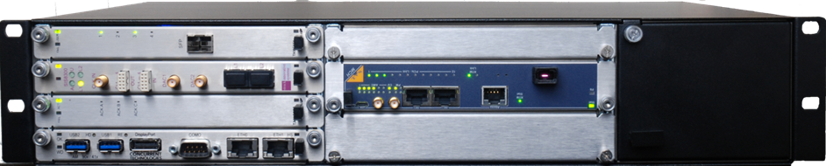
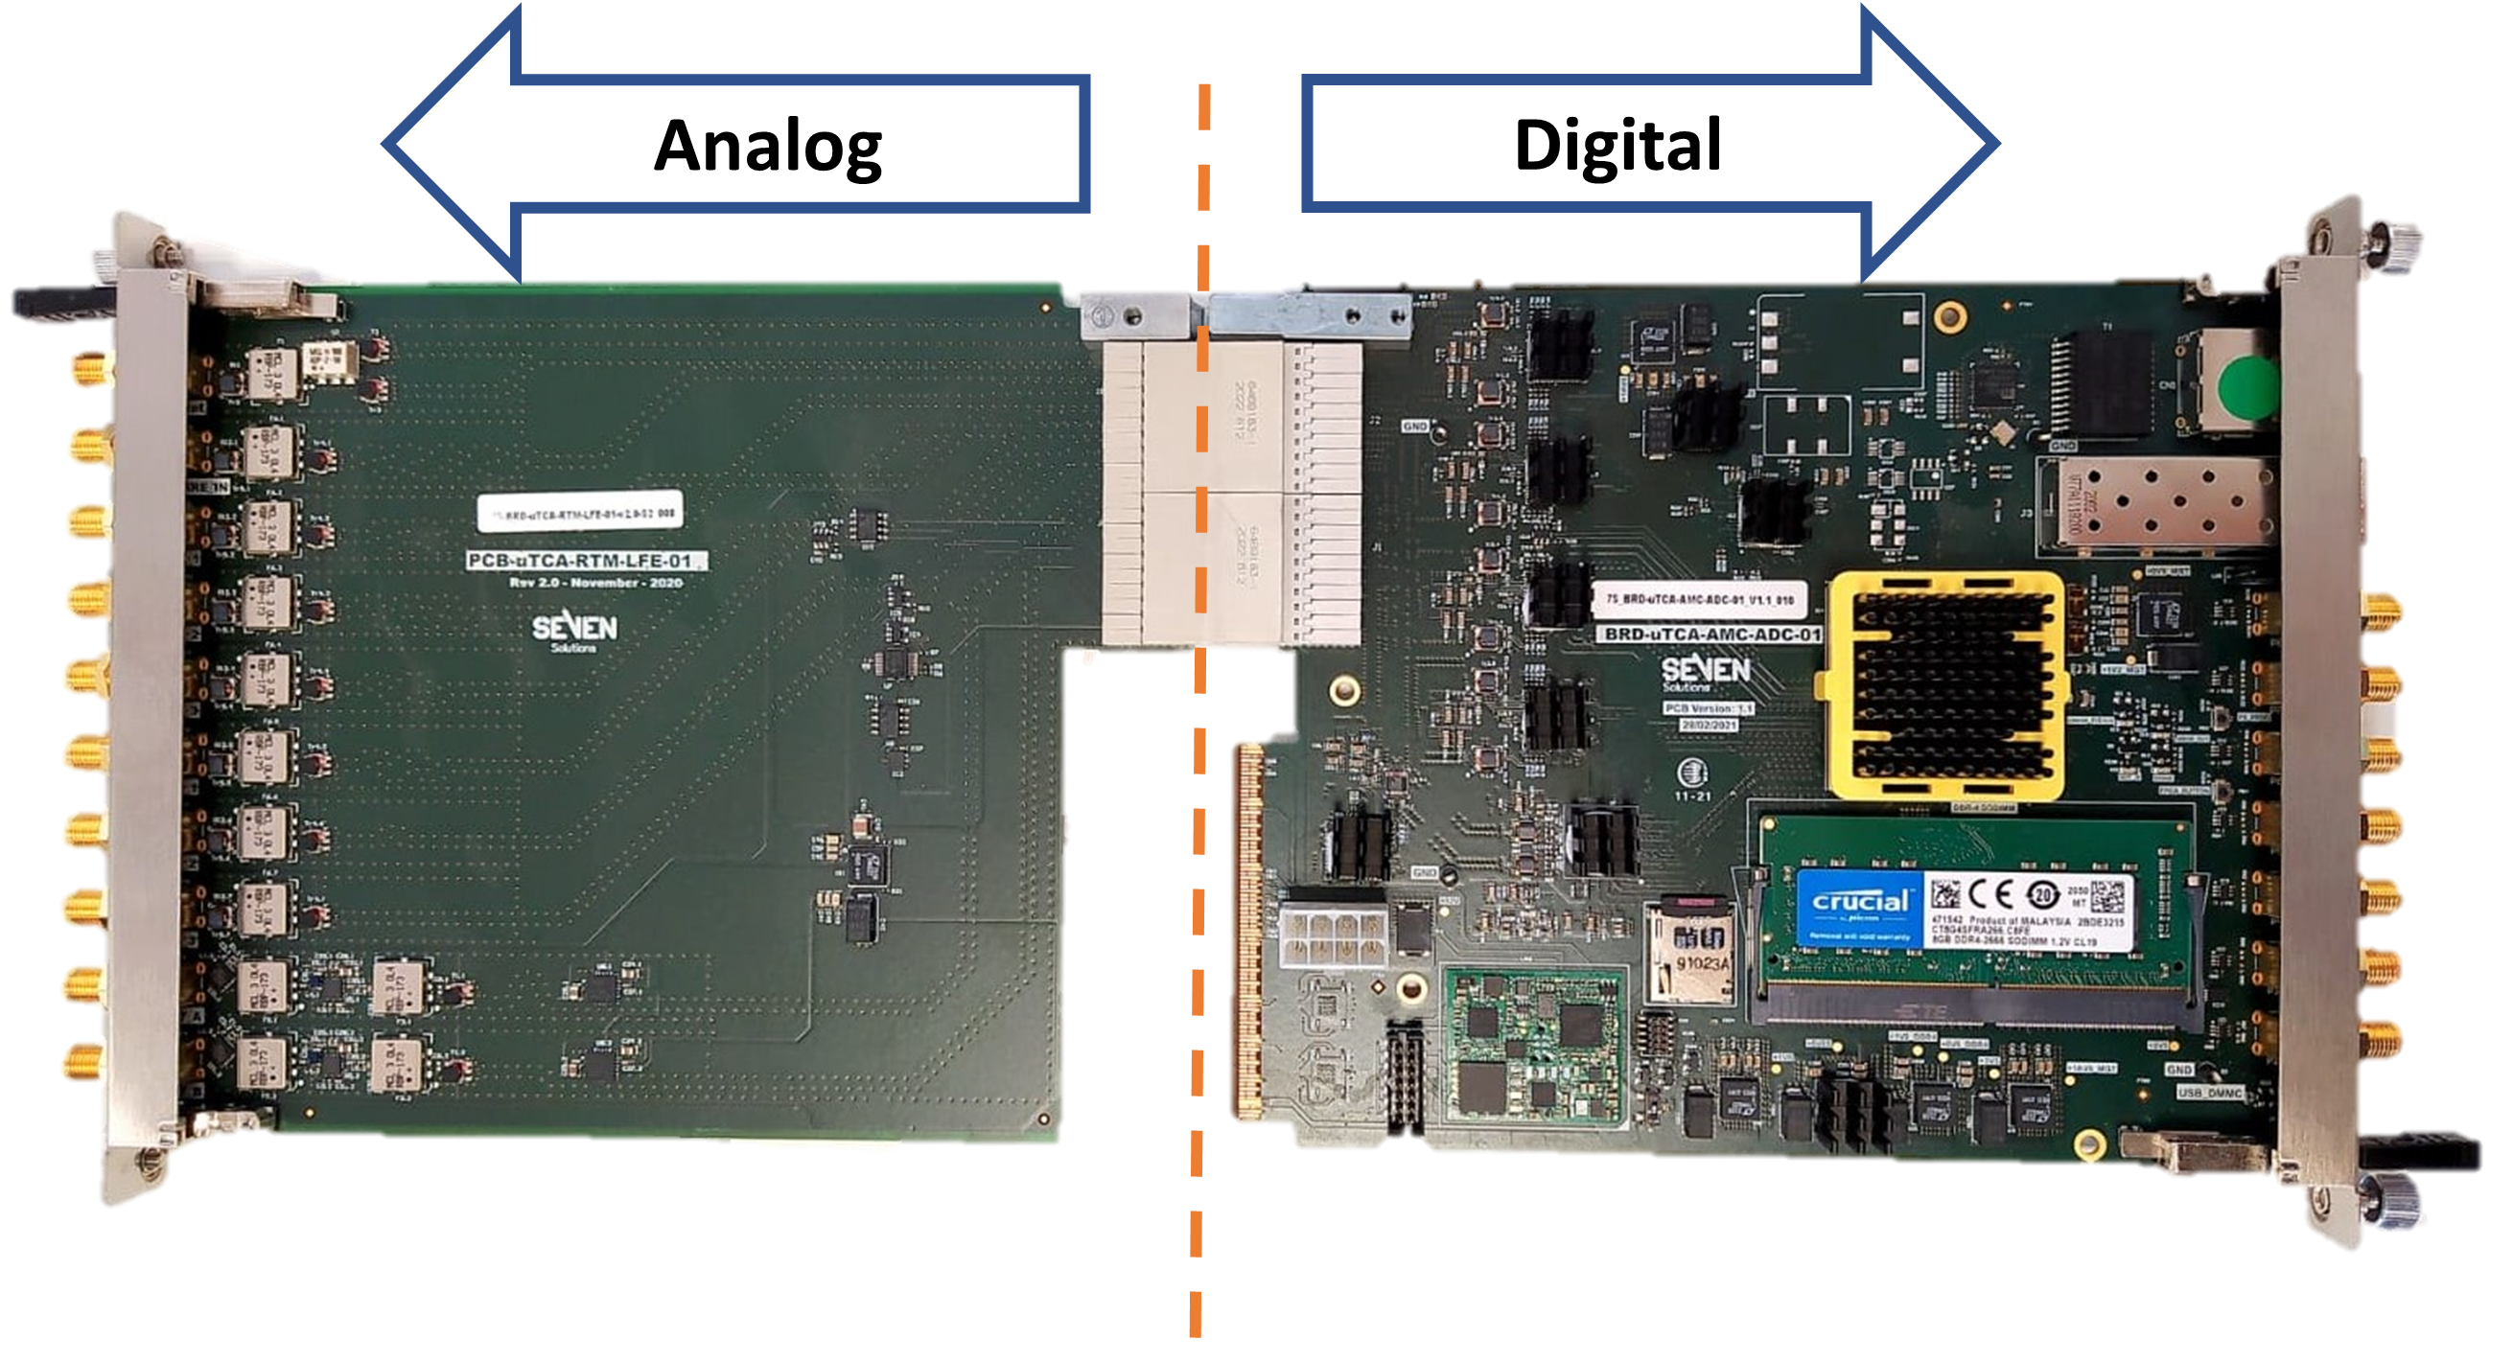

Developments: DLLRF upgrade
500 MHz and 1.5 GHz new DLLRF hardware for ALBA
CfF already awarded to SAFRAN (previous Seven Solutions)
  uTCA based
  20x ADC 16-bit
  500 MHz: Direct RF sampling
  1.5 GHz: Down conversion to 500 MHz
  Non-IQ demodulation
  2 DAC for direct RF output
  MO input for internal PLL
$$f_{ADC}=\frac{N}{M}f_{REF}=\frac{8}{25}500 MHz=160 MHz$$
Parameter | Amplitude | Phase
Precision | 0.05 % | 0.1 Deg

Slide 14

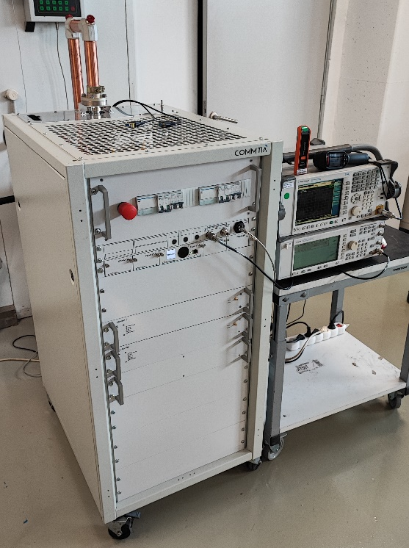
Developments: 3rd harmonic SSPA
1.5 GHz 5 kW SSPA prototype
GaN transistors to maximize efficiency
  72% drain efficiency
  50.1% wall efficiency
  Adjustable drain voltage
SAT approved in October 2022
CfT to be published beginning 2024
Parameter | Value | Unit
P1dB | 67 | dBm
Gain | 67.9 | dB
BW | 5 | MHz
SNR | -73.94 | dBc
Water Flow | 28 | l/min

Slide 15
Developments: 3rd harmonic system schedule
Complete harmonic system installation foreseen for ALBA in 2026.

Slide 16
Summary
Downtime due to RF has reached ~5 hours/year and ~40 hours of MTBI in 2023 .
Major incidence contribution is due to fake arcs detected in optical fibres. Coincidental Arc Detector system is being developed.
RF power consumption reduced by a 5 % in 2023. Extra 5 % reduction is expected for next year 2024.
3HC lengthening has been demonstrated for single bunch and currently efforts are being done for high current multibunch operation.
Complete harmonic system available at ALBA in after summer 2026.
Thanks for your attention

