Slide 1
Overview and Status of the ASTRID2 RF systems
Jørgen S. Nielsen
Center for Storage Ring Facilities (ISA)
Aarhus University
Denmark

Slide 2
Content
Reminder
ASTRID2 facility overview
ASTRID2 RF systems
New 3 GHz RF system for 100 MeV Microtron
3rd harmonic Landau cavity
Beam lifetime and beam stability

Slide 3
ASTRID2
ASTRID2 is the “new” synchrotron light source in Aarhus, Denmark, since 2013
ASTRID2 main parameters
Electron energy: 580 MeV
Emittance: 12 nm
Beam Current: 180 mA
Circumference: 45.7 m
6-fold symmetry
lattice: DBA with 12 combined function dipole magnets
Integrated quadrupole gradient
4 straight sections for insertion devices
Using ASTRID as booster (full energy injection)
Allows top-up operation

Slide 4
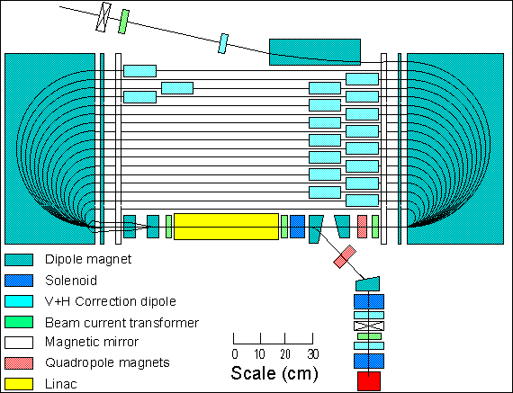
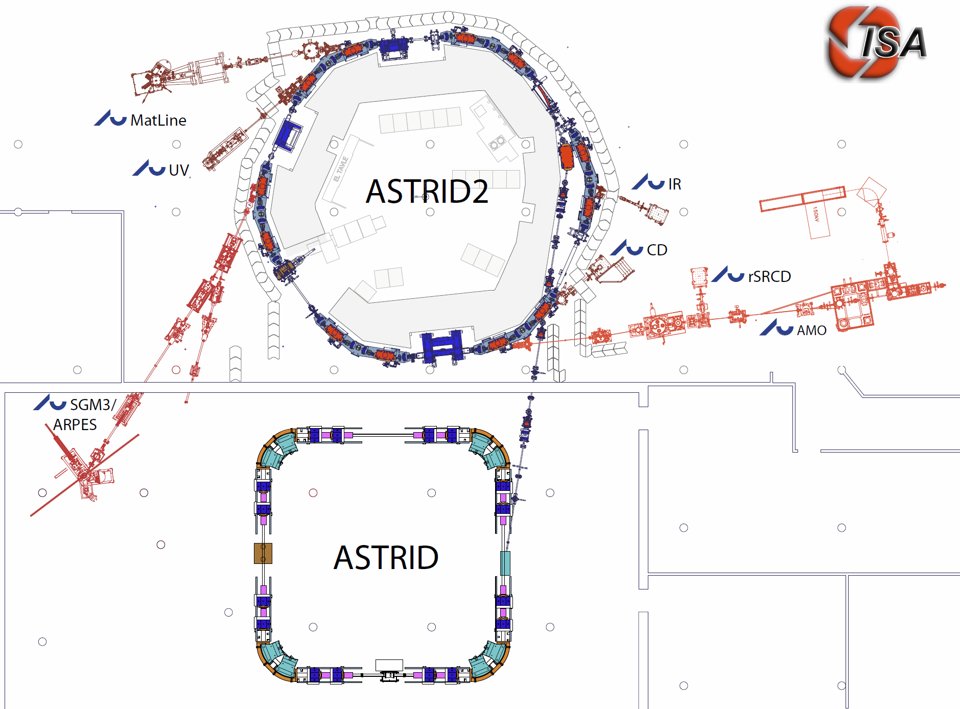
The ASTRID 2 facility
100 MeV Microtron
ASTRID2 main parameters
Circumference 45.71 m
Energy 580 MeV
Current 180 mA
Critical SR energy 257 eV
RF frequency 105 MHz
Harmonic 16
Horiz. emittance 12 nmrad
#Straight sections 6
Length of straight sections 2.82 m
#ID’s 3
10m
Microtron (100MeV)
Notes:
Microtron, Booster, Inj. Bl., A2 ring, 6 beamlines, 7 experiments

Slide 5
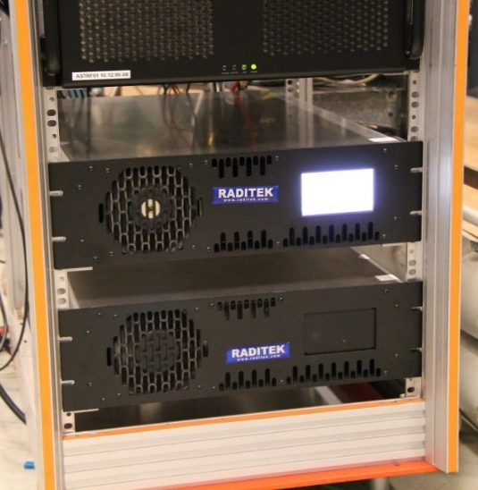
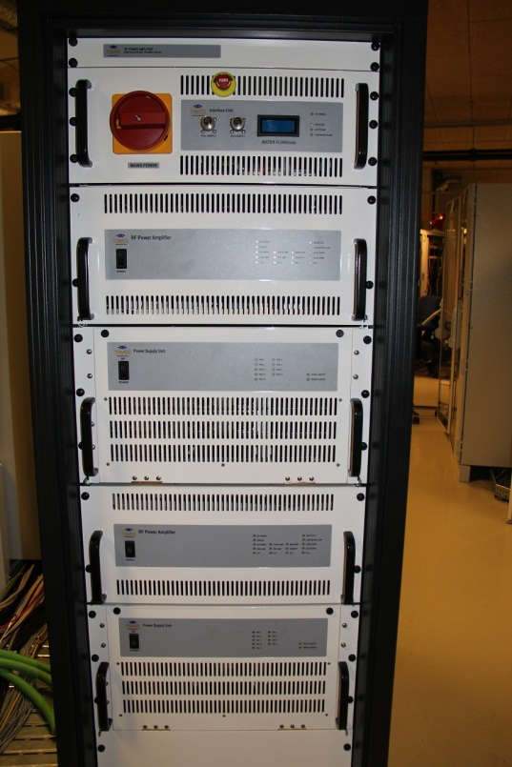
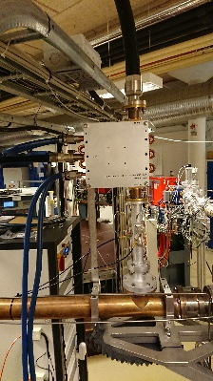
ASTRIDx RF parameters
LLRF computer
Parameter | ASTRID (booster) | ASTRID2
Frequency | 105 MHz | 105 MHz
Harmonic | 14 | 16
RF voltage | 2 - 40 kV | 120 kV
Synchro. freq. | ~10 kHz | 5-15 kHz
SR power | 0 - ~150 W | ~1.1 kW
Cavity power | ~2 - ~500 W | ~4 kW
RF amplifier | ~1 kW SSA from Raditek (USA) (but with new amplifier pallets) | 8 kW SSA from Tomco (Australia)
Circulator | 1 kW avg. | Fwd: 8 kW avg. Refl: 8 kW peak 2 kW avg.
Amplifier
Circulator
ASTRID RF amplifier
ASTRID2
RF amplifier

Slide 6
ASTRIDx LLRF
Since January 2011: New LLRF in operation at ASTRID
Same system for ASTRID and ASTRID2 (except for different tuning control)
Digital control of baseband signals
A computer (PC) running LabVIEW Real-Time with FPGA equipped multifunction card to measure and control the baseband signals
NI PCIe-7852R:
Virtex 5 FPGA, 8 AI, 750 kS/s/ch, 8 AO, 1 MS/s/ch, 16 bit
Detection: IQ demodulators with low pass filter (100 kHz)
±180° phase detection
Control: Amplitude and Phase (voltage controlled)
FPGA (Amplitude Loop): No problems at all
Real-time (Tuning Loop and Phase Control): A restart is occasional necessary (data acquisition loop stops)
Solid State hard disks dies occasional (~5 years)
Have (generally) a spare disk ready in the computers which quickly can be switched to
Very happy with the systems

Slide 7
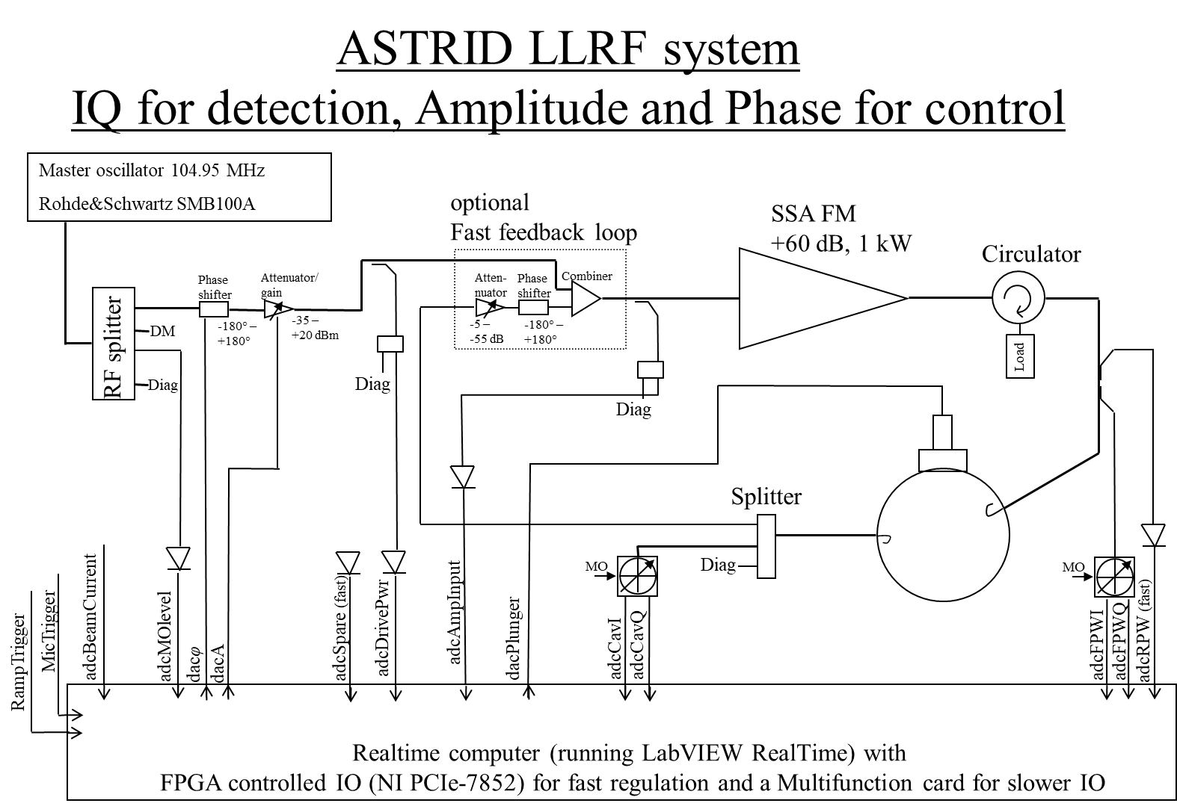
Notes:
Drawing from \\isasvr14\isadfs\Nat_ISA-Ast2Doc\machine\Documentation\RF\LLRF\IQ_Ampl_phase-simplifiedDrawing-231031_jsn.pptx

Slide 8
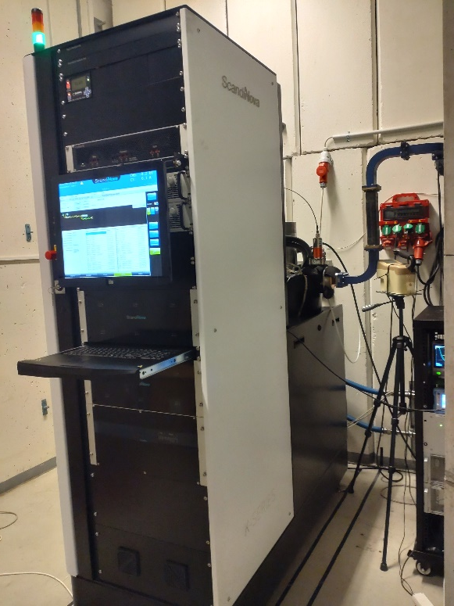
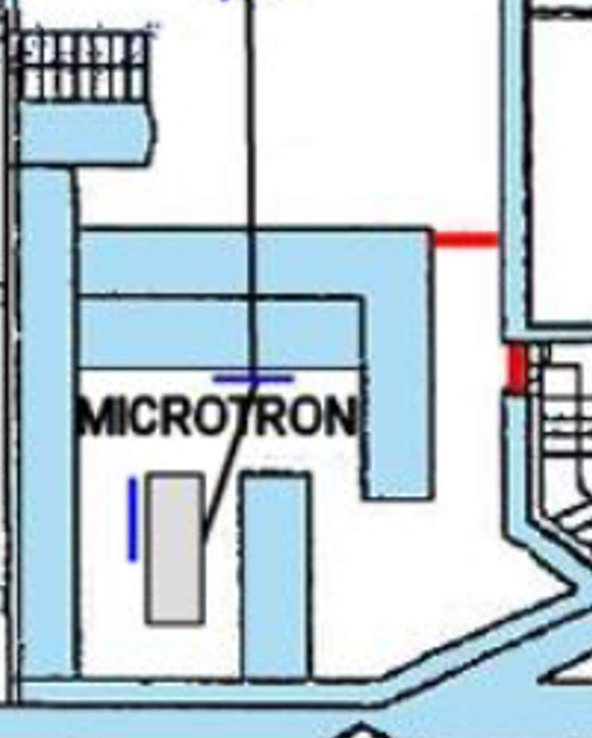
New Microtron modulator
ScandiNova K100 standard solid-state modulator with Canon E3779,B klystron
3 GHz, 7.5 MW (need ~3.5 MW)
~3 µs pulse length
<10 Hz rep. rate (typical < 2 Hz)
Has been placed outside Mic. bunker with a new waveguide to the Linac
Was delivered in September 2022 and installed October-November 2022
Has replaced the >30 years old PFN
Had one PFN feeding both klystron and e-gun (two transformers in oil-tank)
Now have a separate modulator for the e-gun
K100 unit
K100

Slide 9
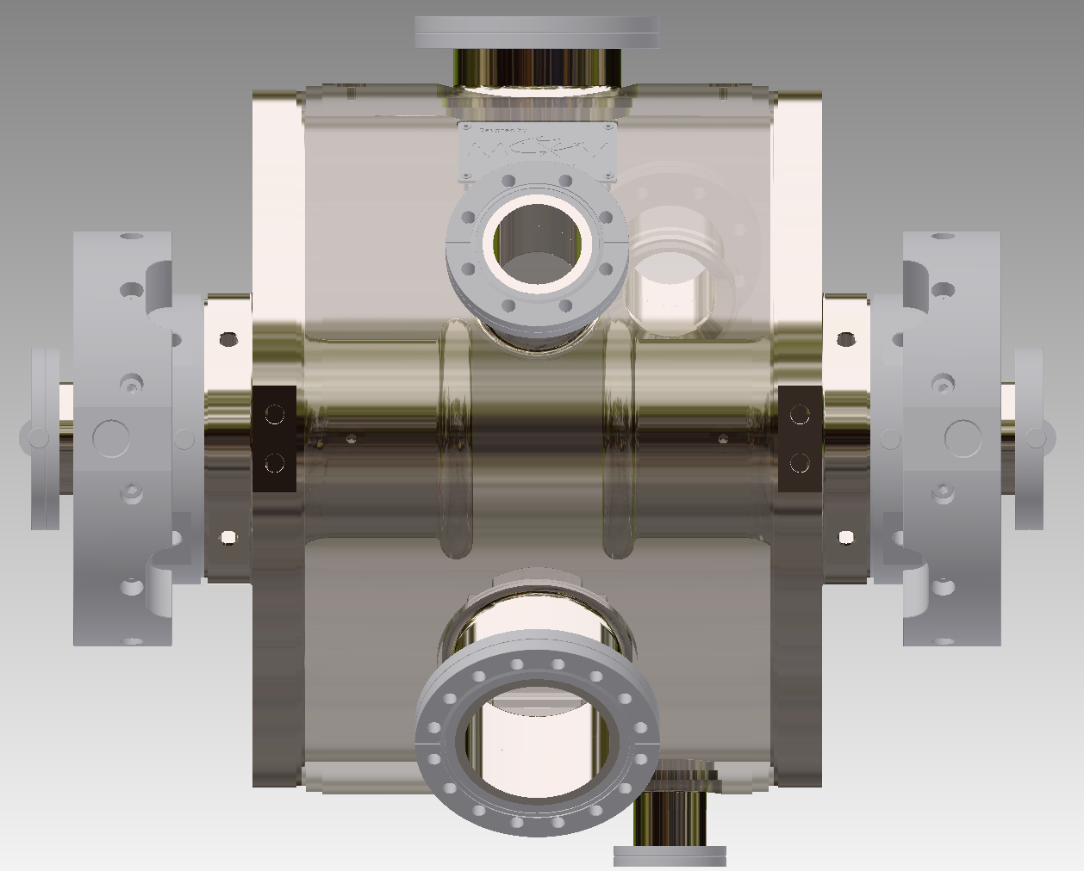
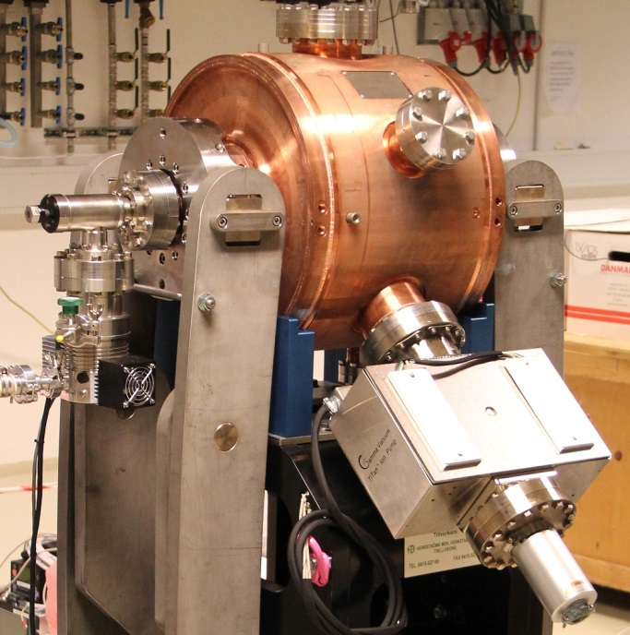
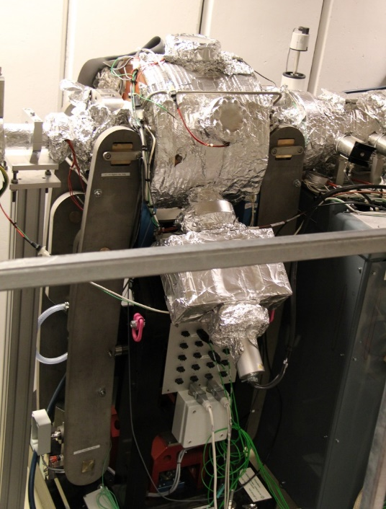
ASTRID2 3rd harm. cavity
Copy of MAX IV cavity, except 315 MHz
Cavity stub end diameter changed
Thanks to Åke and MaxLab
Installed March 2015
Fixed cooling water temperature of ~20°C (at the time)
Before installation
Installed in the ring

Slide 10
Benefits (at installation time)
Better lifetime
Before: 1.4 h @ 80 mA and 1.0 h @ 120 mA
After: 2.0 h @ 80 mA and 1.85 h @ 120 mA
More stable beam
Moved instabilities to higher frequencies
SR diagnostic camera (in control room) showed a more stable beam (and happy users)
Good tuning range is limited
Was for long using a detuning of around +400 kHz (possible tuning range is ±500 kHz).
“Theoretical optimum” (flat potential) should be +160 kHz
Large beam instabilies at a detuning of ~300 kHz

Slide 11
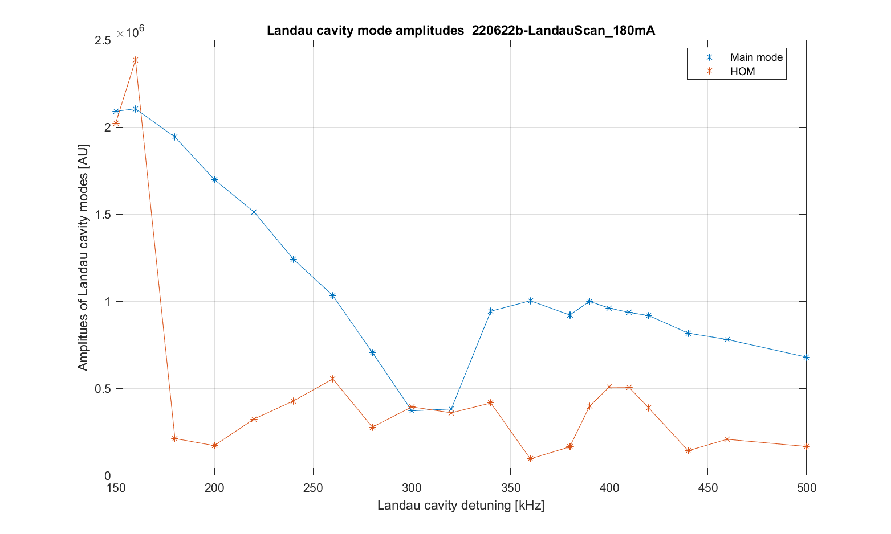
Cavity detuning scan
With the cavity at 20°C, we see a strong dip in amplitude of the fundamental around a detuning of ~300 kHz, and the beam becomes very unstable
HOM is rev. harm. 177
Beam
very
unstable
Beam has been accumulated at a cavity detuning of +400 kHz
Notes:
Figure is 220622b-LandauScan_180mA_LandauAmplitudes.png from \\isasvr14\isadfs\Nat_ISA-Astrid2\AccPhys\Instabilities\BeamModeMeas\220621-Scope03with3moreSignals\220622b-LandauScan_180mA\analyse\FFTplots
HOM is rev. harm. 177

Slide 12
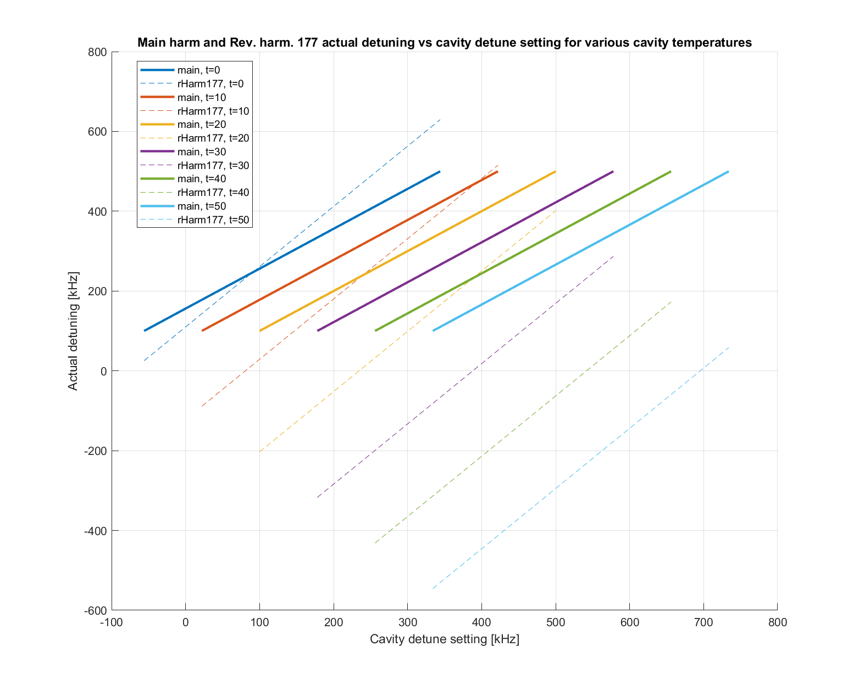
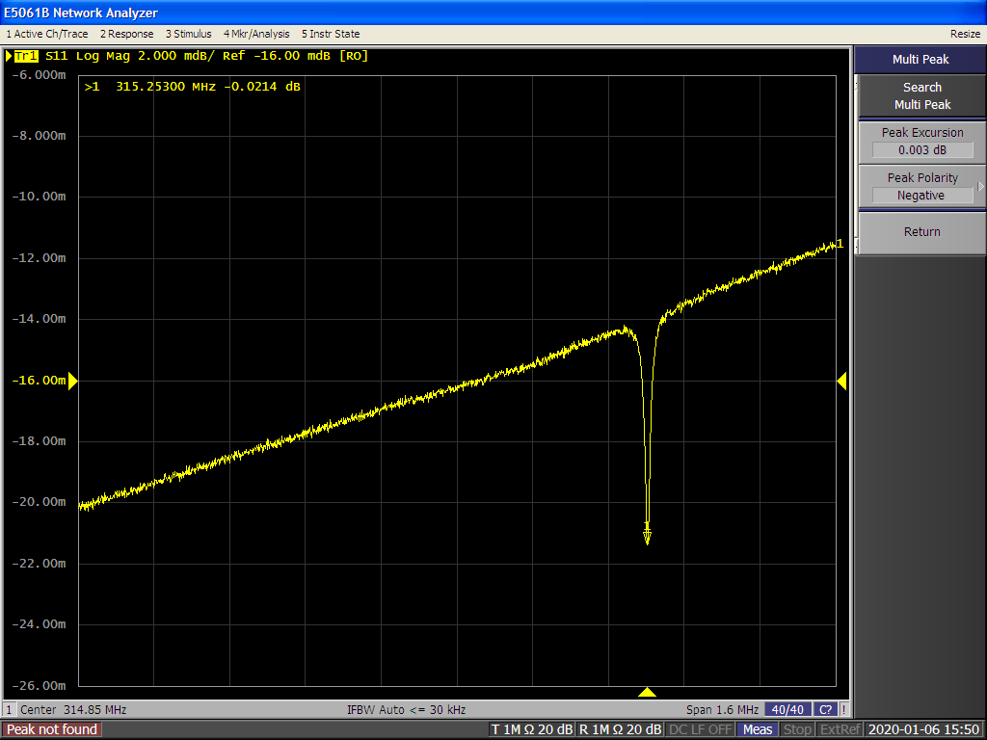
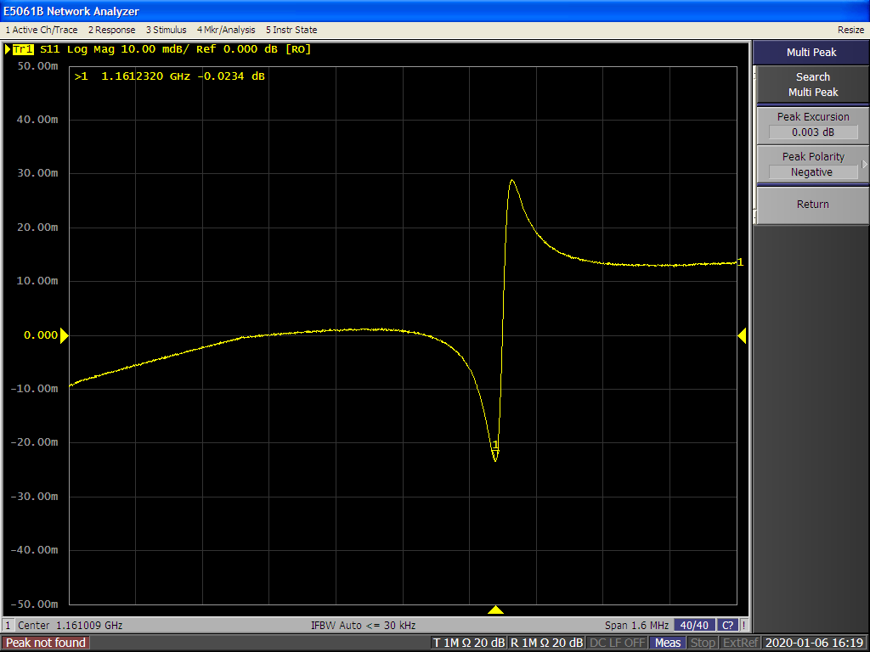
Temperature dependance
Have recorded all resonances with a network analyzer for various cavity temperatures (baking the cavity)
This tells us the resonance is at revolution harmonic 177
Main resonance
20°C, detune setpoint = 400 kHz
Cooling
Calculation based on fits
Nominal
Heating
Cavity actual detune [kHz]
Rev. Harm. 177
20°C, detune setpoint = 400 kHz
Cavity detune set [kHz]
Notes:
(Raw) Cavity scans are from \\isasvr14\isadfs\Nat_ISA-Astrid2\AccPhys\RF\LandauCavity\191217-HOMinvestigations\191231a-RevHarmTuningScan\RawAnalyzerScreens, rHarmTscan_43_h48 and _h177 (20°C, detuning setpoint is 400 kHz), see ELOG 1438 Rev. harm. 177 resonance is taken as the middle of the sharp flank.
Calculated plot of main and revHarm177 resonances are from \\isasvr14\isadfs\Nat_ISA-Astrid2\AccPhys\RF\LandauCavity\191217-HOMinvestigations\191231a-RevHarmTuningScan\calculations

Slide 13
Increase cavity temperature
In August 2022, a small (borrowed) cooler/heater (10-40°C) was installed for our 3rd harm. cavity
No remote control, temperature stability is ~0.3°C
By raising the 3rd harm. cavity temperature (above ~30°C) we can operate stable at smaller main resonance detuning (“jumping” below the RevHarm177 resonance)
Beam lifetime and/or beam stability is better
But keeping good beam stability is not always easy
The detuning range with stable beam is (still) rather narrow
We often experience an increase in vertical beam size and/or increased jitter in vertical beam size
This increase the measurement noise at some of the beamlines
Settings depend strongly on cavity temperature, making it difficult to achieve stable beam in Decay mode (where beam induced voltage change)
Believe this vertical instability (partly) is caused (or influenced) by ions captured by the beam
Should be able to condition this away, and we do see improvements (but slowly)
We often see a memory effect
Change a parameter to a new value and then back again, does often not restore beam parameters (beam size and beam lifetime)
Notes:
MRS441 camera picture is MRS441CAM_220925_191316_180mA_scr.png from \\isasvr14\isadfs\Nat_ISA-Astrid2\AccPhys\Instabilities\BeamModeMeas\220921-OptimizeWithSmallCooler_Scope06\220925g-Accum180mA_noScopeData

Slide 14
Different operation modes
Dependent of cavity temperature we have different modes:
Note that the horizontal beam size and jitter in the dipoles is (mostly) determined by longitudinal oscillations and variations (there is dispersion in the dipoles)
For the “hot” cavity we have had varying trouble with stability of the vertical beam size
The stability of the horizontal (and longitudinal) dimension is not so important for our beam lines (most have horizontal slits)
Vertical beam size (and thereby beam lifetime) can be varied by changing skew quadrupoles
Cav. temp. | Cav. detuning | Beam lifetime | Horizontal beam size at dipoles
~20°C | ~400 kHz | 1.5-2.0 h | Large and noisy
40°C | ~185 kHz | ~5 h | Large and noisy
38°C | ~185 kHz | 1.5-2.0 h | Small and stable
Notes:
MRS441 camera picture is MRS441CAM_220925_191316_180mA_scr.png from \\isasvr14\isadfs\Nat_ISA-Astrid2\AccPhys\Instabilities\BeamModeMeas\220921-OptimizeWithSmallCooler_Scope06\220925g-Accum180mA_noScopeData

Slide 15
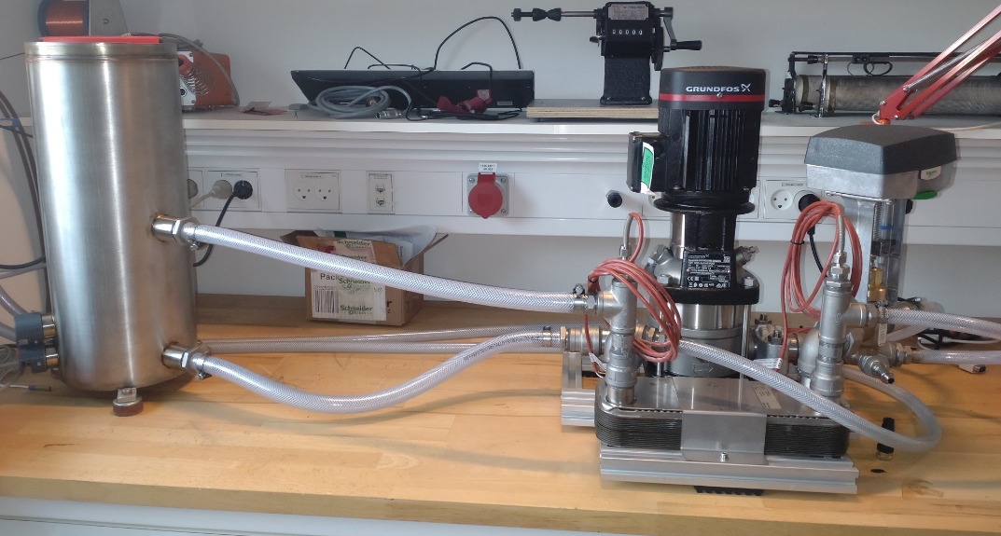
Future developments
We expect vertical stability to improve with time due to (vacuum) conditioning
Better vacuum => less ions captured by the beam
We are presently building a new cooling water system for the 3rd harmonic Landau cavity
Better temperature stability (<0.1°C)
Remote control
Easier to try new settings (temperature scans)
Can change setpoint for instance as beam current changes
Expect (hope) to commission the system in December
Build a (vertical) Bunch-by-Bunch feedback system ??
This will be a large project for us
New cooler system on
the test bench in the lab
Notes:
MRS441 camera picture is MRS441CAM_220925_191316_180mA_scr.png from \\isasvr14\isadfs\Nat_ISA-Astrid2\AccPhys\Instabilities\BeamModeMeas\220921-OptimizeWithSmallCooler_Scope06\220925g-Accum180mA_noScopeData

Slide 16
Thank you for your attention

Slide 17
Extra (spare) slides

Slide 18
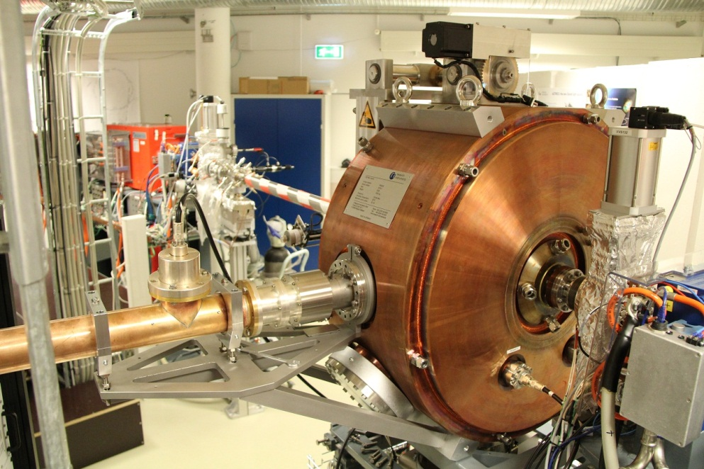
ASTRID2 Cavity
Basically, the same as MAX IV cavities
Built by RI (RF design by MaxLab)
Has been conditioned to ~150 kV (~5 kW)
No problems seen
Usual operate at 120 kV (~3.5 kW)
Have a 315 MHz Landau cavity (also from RI and based on MaxLab design).
Installed March 2015

Slide 19
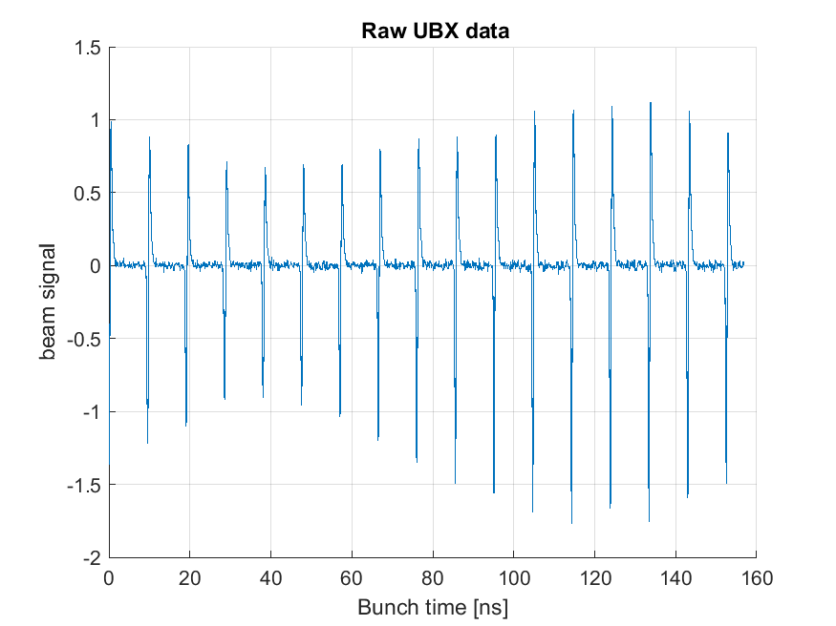
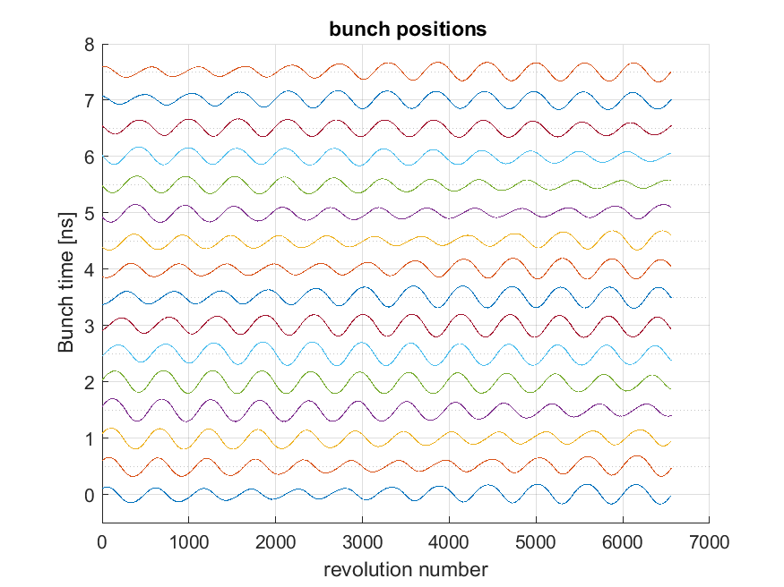
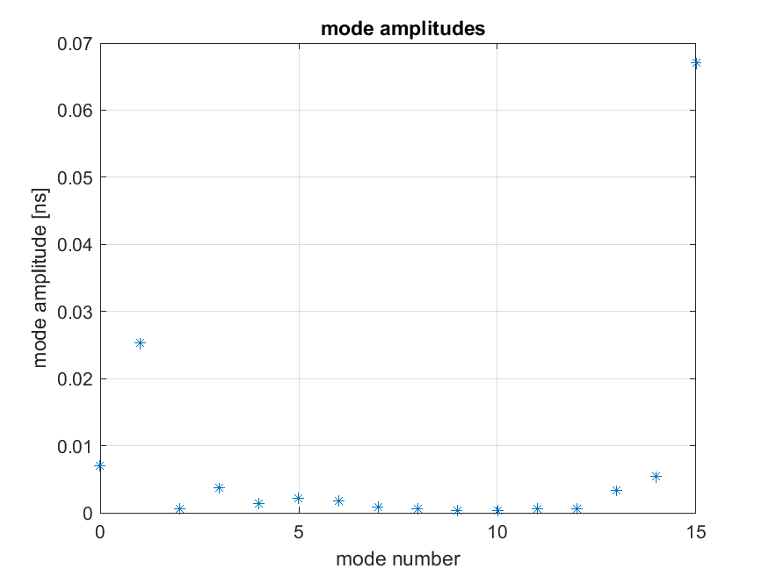
LCBI, 180 mA, Landau cav. at 20°C, detune 400 kHz
220624c-BeamAccumAtLandau400kHz
Notes:
plots from \\isasvr14\isadfs\Nat_ISA-Astrid2\AccPhys\Instabilities\BeamModeMeas\220621-Scope03with3moreSignals\220624c-BeamAccumAtLandau400kHz\BeamModeData

Slide 20
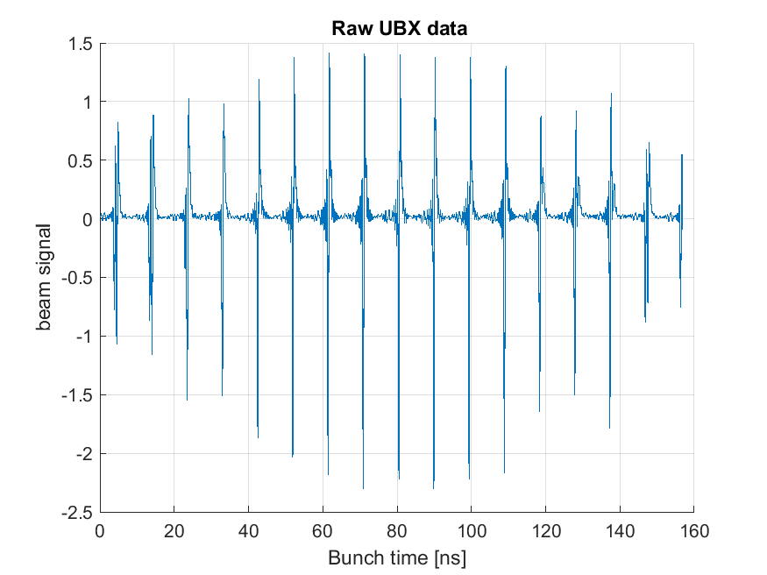
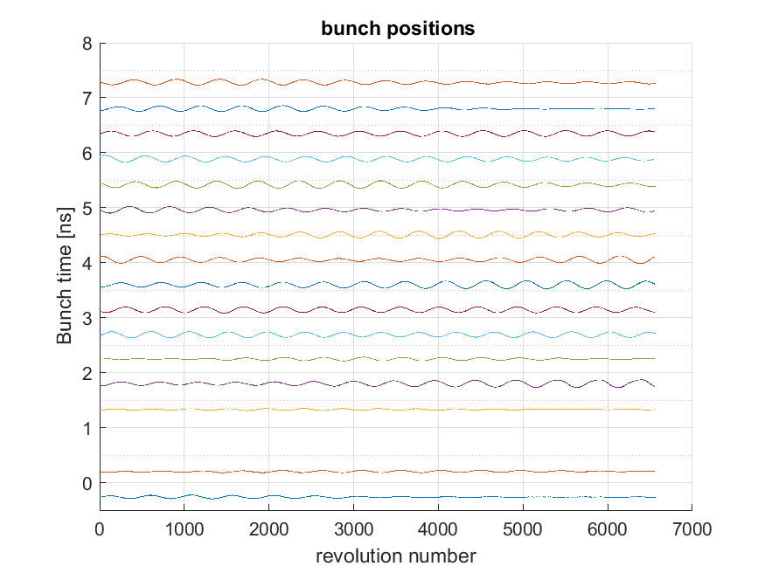
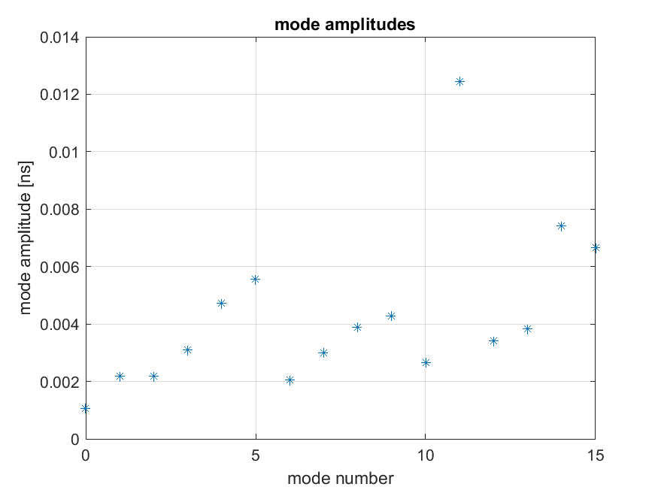
LCBI, 180 mA, Landau cav. at 30°C, detune set 320 kHz (actual 240 kHz)
220925d-BeamAccumAtLandau320kHz30degC
Notes:
plots from \\isasvr14\isadfs\Nat_ISA-Astrid2\AccPhys\Instabilities\BeamModeMeas\220921-OptimizeWithSmallCooler_Scope06\220925d-BeamAccumAtLandau320kHz30degC\BeamModeData

Slide 21
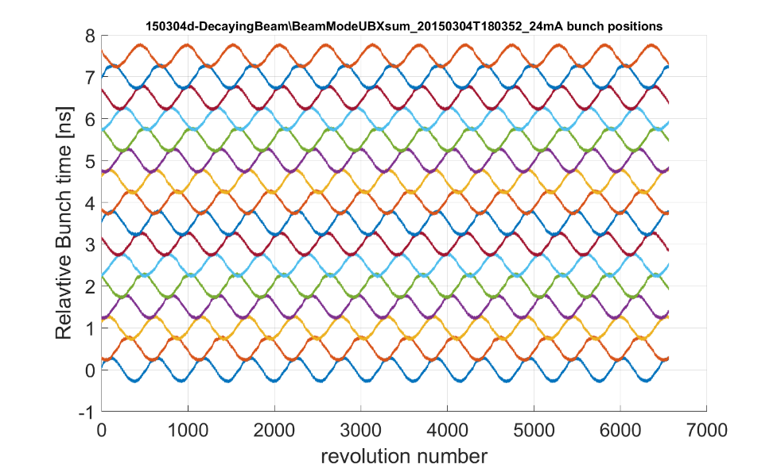
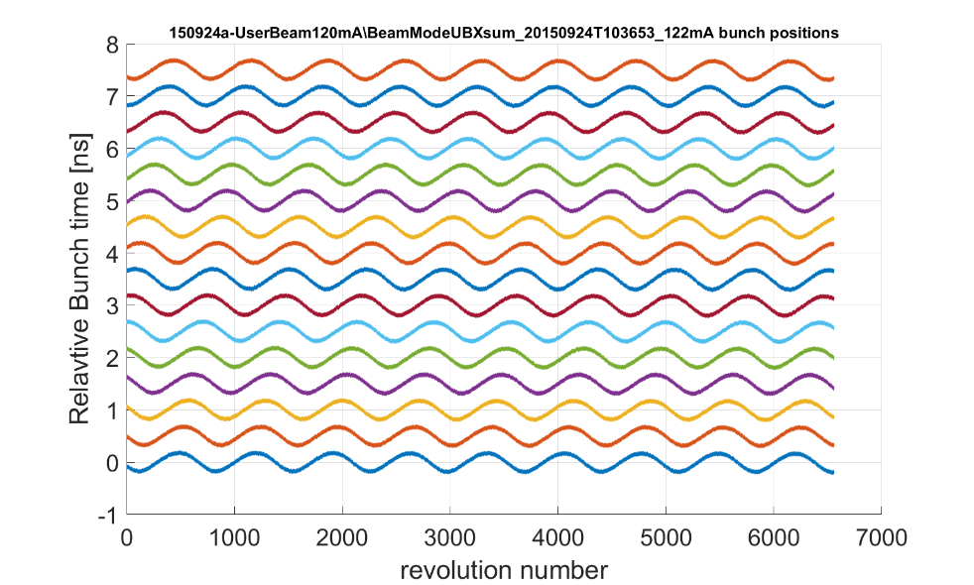
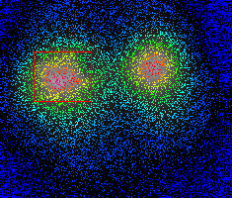
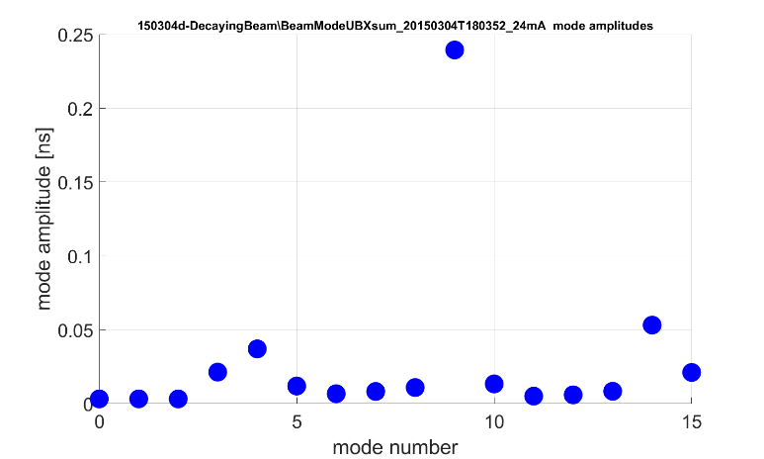
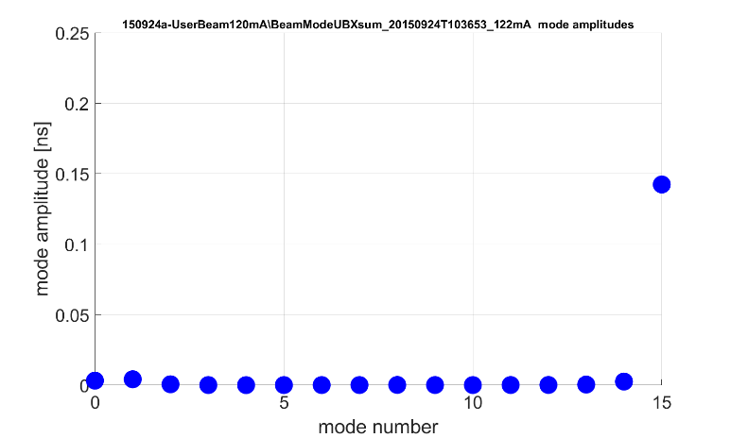
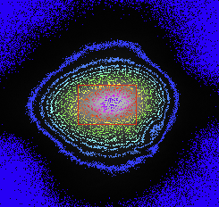
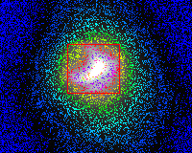
LCBI
After installation of 3rd cavity Longitudinal Coupled Bunch Instability (LCBI) mode spectra changed
Before Landau cavity (24 mA)
Dominant mode: 9
With Landau cavity (120 mA)
Dominant mode: 15
Relative bunch time [ns]
measured with fast oscilloscope
Notes:
Data from before Landau cavity is from \\isasvr14\isadfs\Nat_ISA-Astrid2\AccPhys\Instabilities\BeamModeMeas\150304-OneChannelMeasurements\RePlot_221005_forHarmonLIP\150304d-DecayingBeam
Data from after Landau cavity is from \\\isasvr14\isadfs\Nat_ISA-Astrid2\AccPhys\Instabilities\BeamModeMeas\150911-SingleChMeasWithLandauCavity\RePlot_221005_forHarmonLIP\150924a-UserBeam120mA (BeamModeUBXsum_20150924T103653_122mA)
MRS441 camera picture for Before Landau cavity is from
MRS441 camera picture for With Landau cavity is 160120_085846-ScrDumpOfMRS441videoProgram.png from \\isasvr14\isadfs\Nat_ISA-Astrid2\AccPhys\Diagnostics\MRS\160119-NewFitsChangesBeamsizes

Slide 22
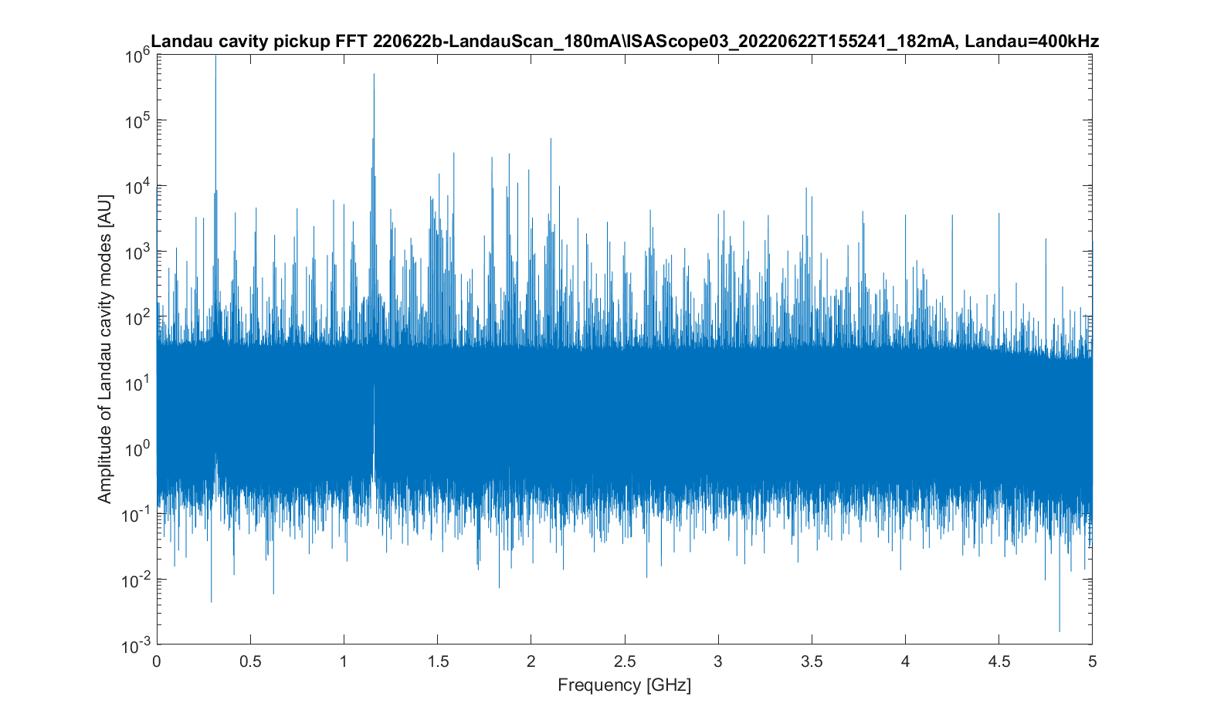
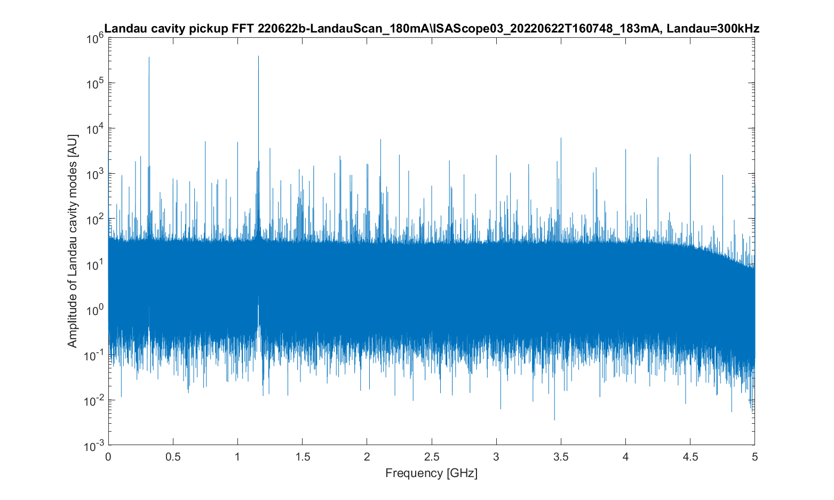
Strong HOM at rev. harm. 177
Direct sampling of Landau cavity pickup signal with (fast) scope and then FFT
Detuning = +400 kHz
Detuning = +300 kHz
Fundamental (315 MHz)
Rev. harm. 177 (1.16 GHz)
Beam has been accumulated at a cavity detuning of +400 kHz
and a cavity temperature of ~20°C

Slide 23
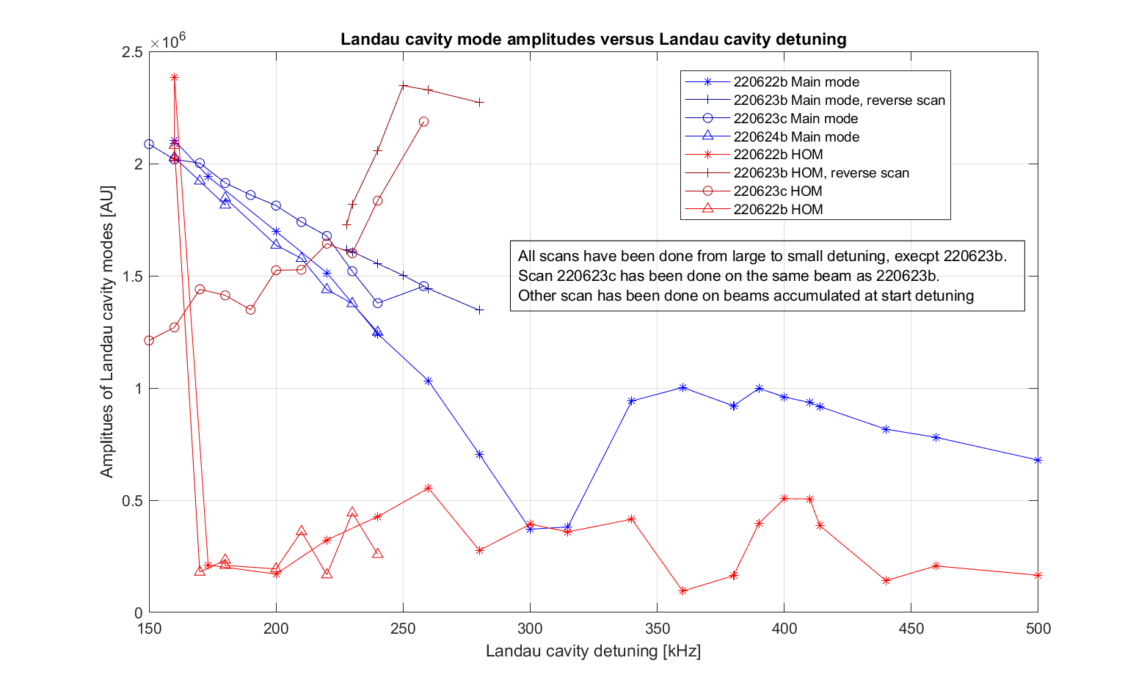
Accumulate at various detuning's
Cavity behavior depends on “history”
Notes:
Figure is LandauScan_LandauCavModeAmplitudes.png from \\isasvr14\isadfs\Nat_ISA-Astrid2\AccPhys\Instabilities\BeamModeMeas\220621-Scope03with3moreSignals\analyse\LandauFFTplots

Slide 24
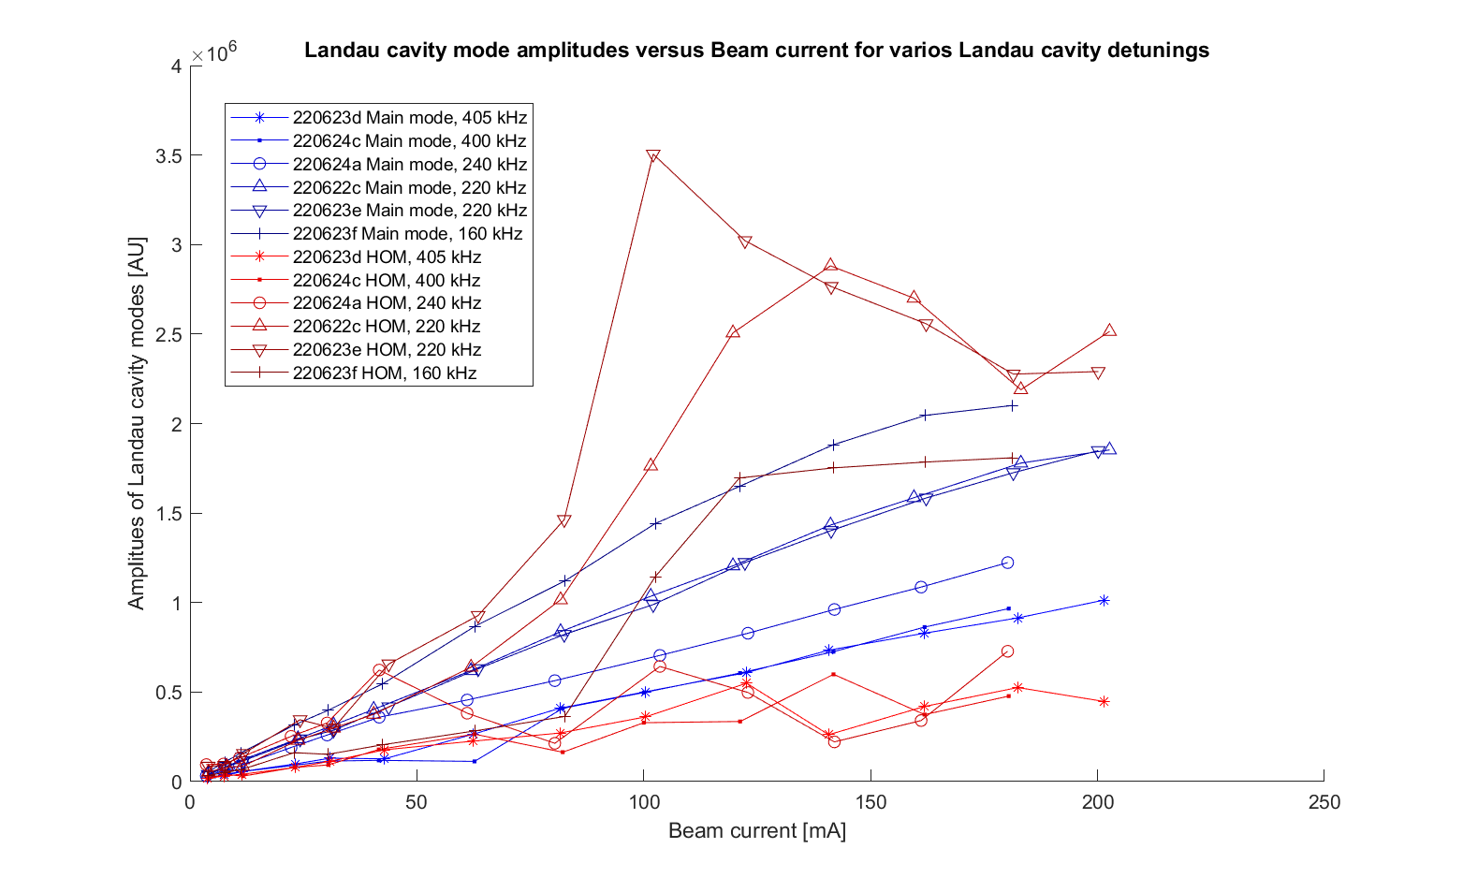
Beam accumulation
Cavity amplitudes as function of beam current
Amplitude of fundamental (blue) increases as detuning is lowered
But amplitude of RevHarm177 (red) are more irregular, but with a tendency that smaller detuning give much more amplitude of harmonic
Notes:
Plot is BeamCurrentAccum_LandauCavModeAmplitudes.png from \\isasvr14\isadfs\Nat_ISA-Astrid2\AccPhys\Instabilities\BeamModeMeas\220621-Scope03with3moreSignals\analyse\LandauFFTplots

Slide 25
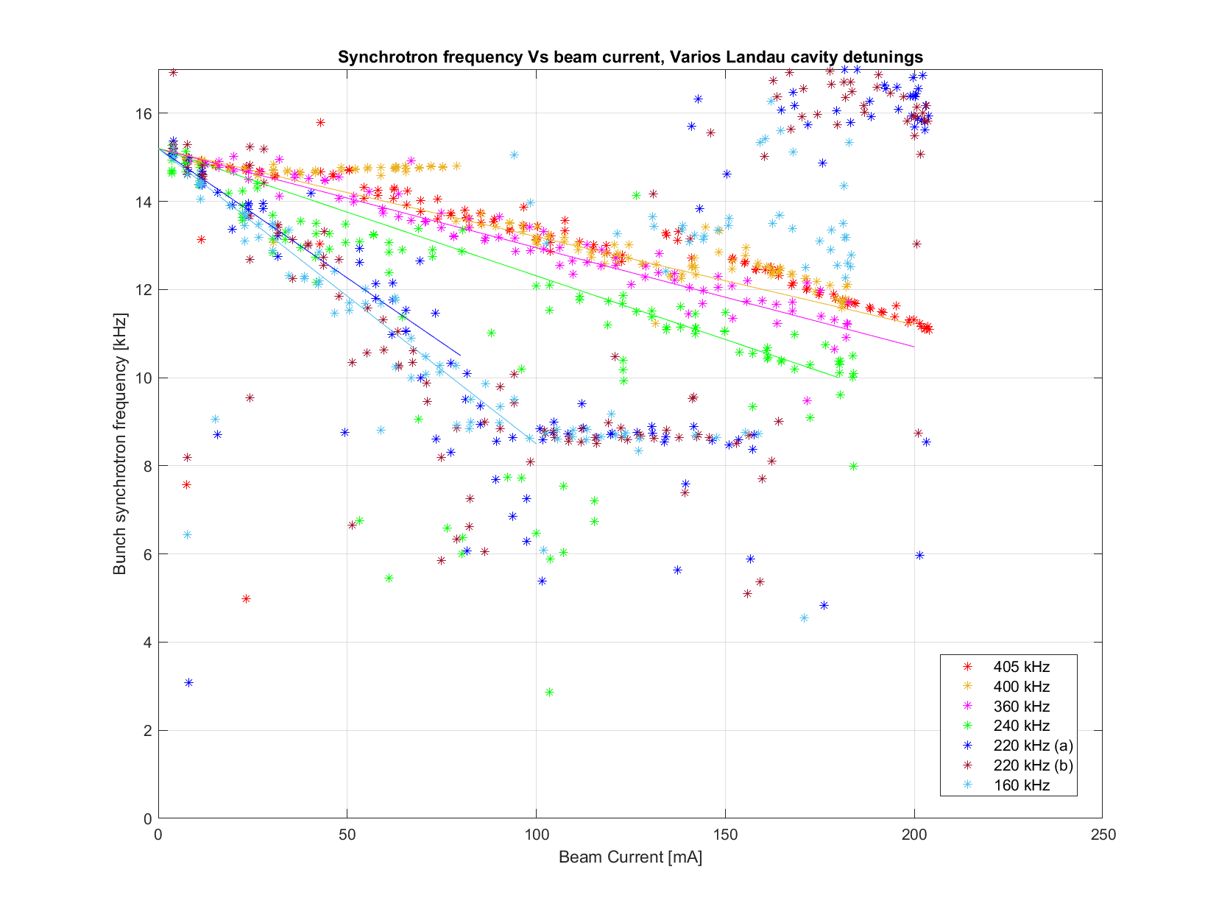
Synchrotron frequency
Synchrotron frequency gives a measure of total voltage seen by the beam (or rather slope around synchronous point)
Notes:
Plot is EvenFill_VsBeamcurrent_fSync.png from \\isasvr14\isadfs\Nat_ISA-Astrid2\AccPhys\Instabilities\BeamModeMeas\220621-Scope03with3moreSignals\analyse\CSdata

Slide 26
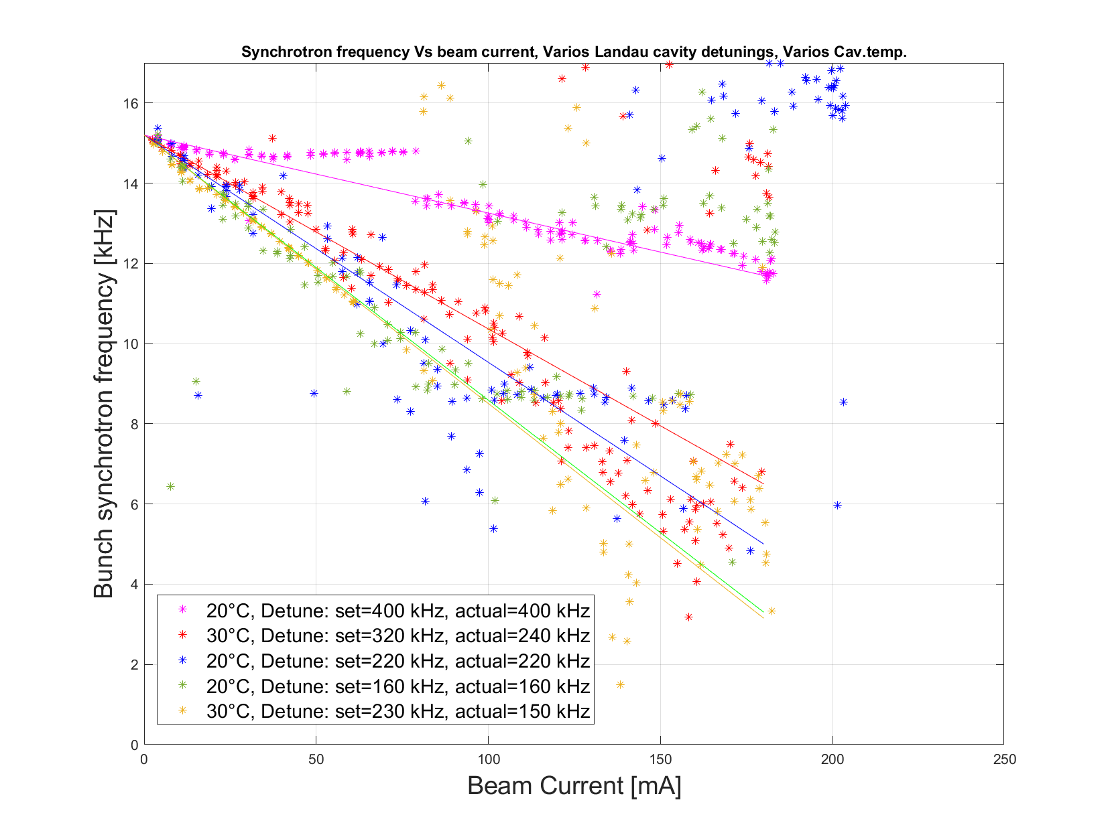
Sync. freq. vary cav. temperature
Synchrotron frequency measurements are consistent for various cavity temperatures
Notes:
Plot is EvenFill_VsBeamcurrent_fSync.png from \\isasvr14\isadfs\Nat_ISA-Astrid2\AccPhys\Instabilities\BeamModeMeas\220921-OptimizeWithSmallCooler_Scope06\analyse\HarmonLIPworkshop\Comparison20and30degC

Slide 27
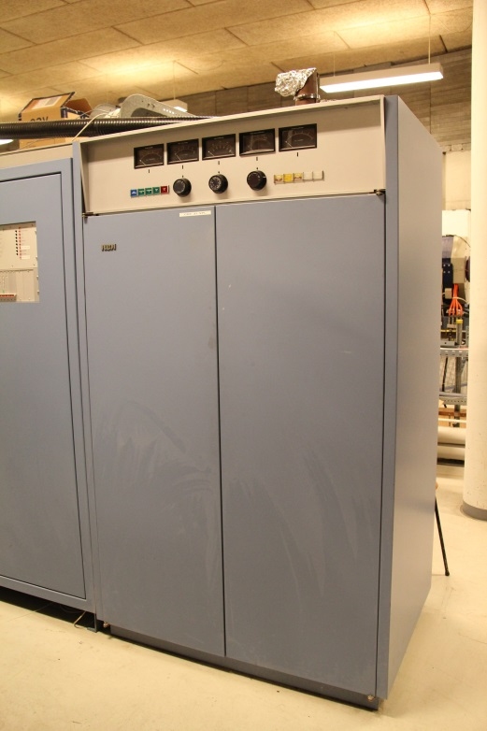
New ASTRID RF power amp.
1 kW Solid State from Raditek Inc.
Replaces the ~25 year old 8 kW tetrode amplifier
Saves electrical power
Idle power consumption:
Tetrode: ~7 kW
Raditek: ~150 W
Old amplifier
Amplifier
Circulator

Slide 28
New ASTRID RF power amp.
1 kW power module:
Commercial FM module
Amplifier
Circulator

Slide 29
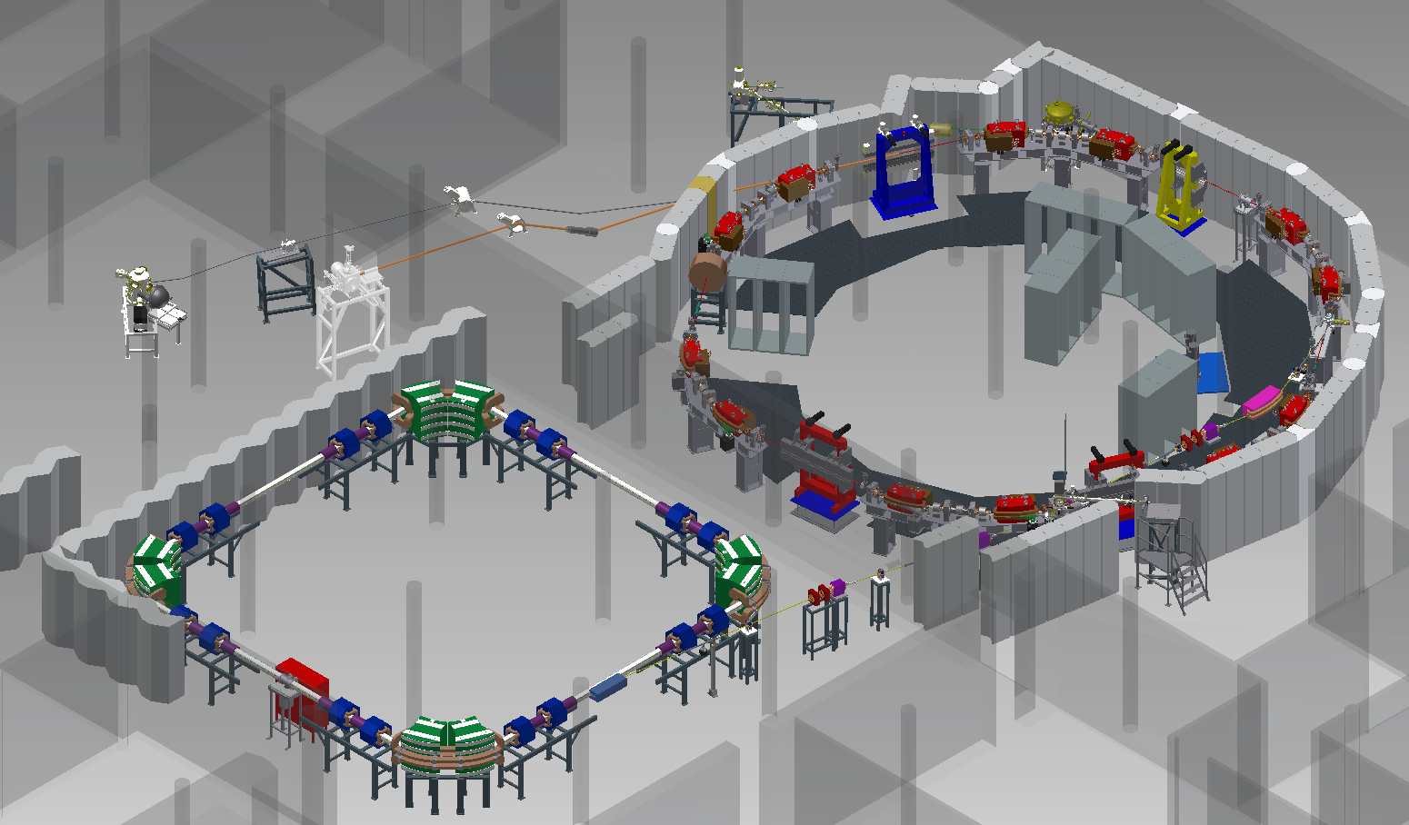
ASTRID2 Layout

Slide 30
Landau cavity
Installed March 2015
Prebaked (130°C)
Preconditioned with 100 W (~20 kV)
Multipactoring around 10 W (200 V)
Installed in the ring

