Slide 1
HOM Dampers for the
MAX IV 100 MHz RF Cavities

Slide 2
Outline
Introduction
  Motivations
  HOM Damper Guidelines
HOM Dampers EM Design
  HOMs
  All-but-L7 HOM Dampers
  Simulation Studies
Cold RF Measurements
Final Remarks

Slide 3
Introduction

Slide 4
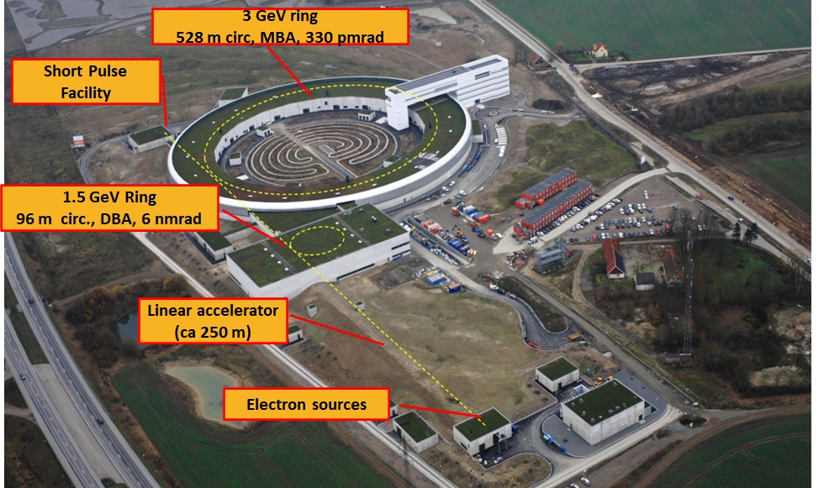
The MAX IV Accelerators
Slide by S. Werin

Slide 5
Motivations
HOMs in the MAX IV 3 GeV ring 100 MHz cavities are the main driving force of coupled-bunch motion.
Several effective mitigating measures have been in place since several years:
  Harmonic cavities
  Feedback systems
  Cavity temperature tuning
HOM dampers will provide improved repeatability of beam conditions by removing the very driving forces of coupled bunch motion rather than counteracting their effects through feedback or increased synchrotron frequency spread.

Slide 6
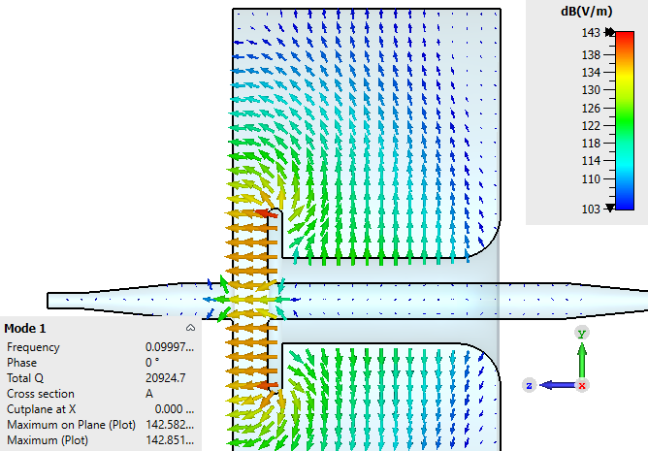
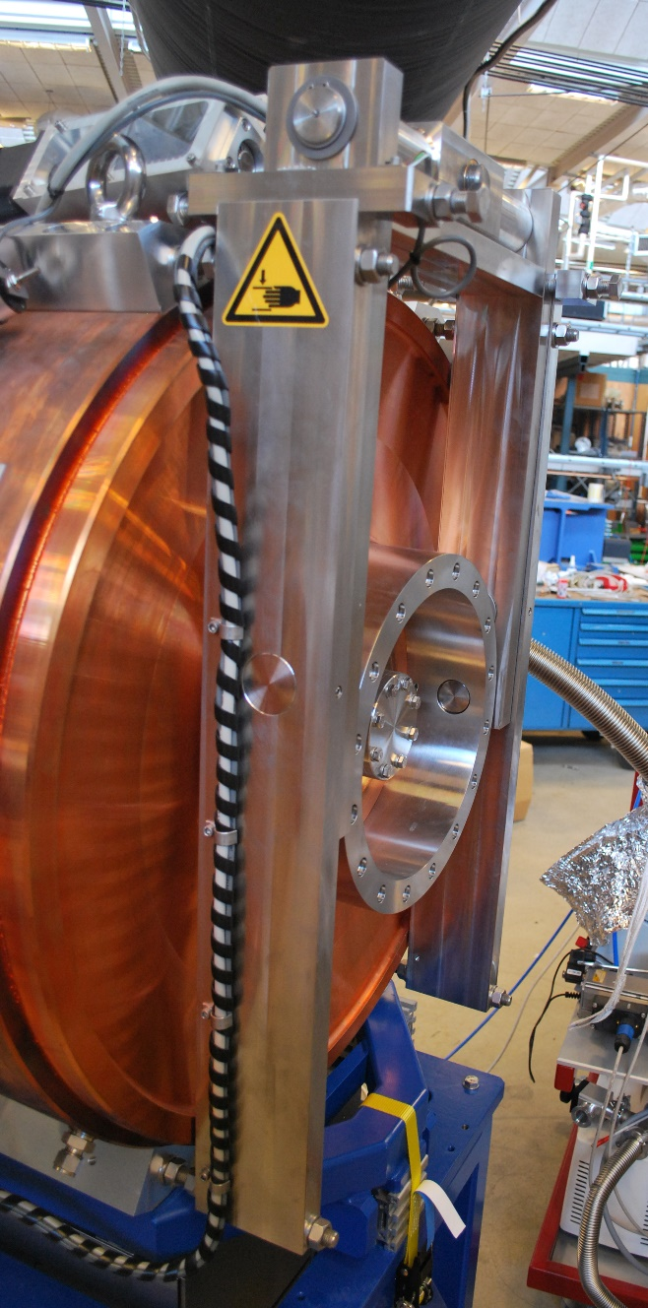
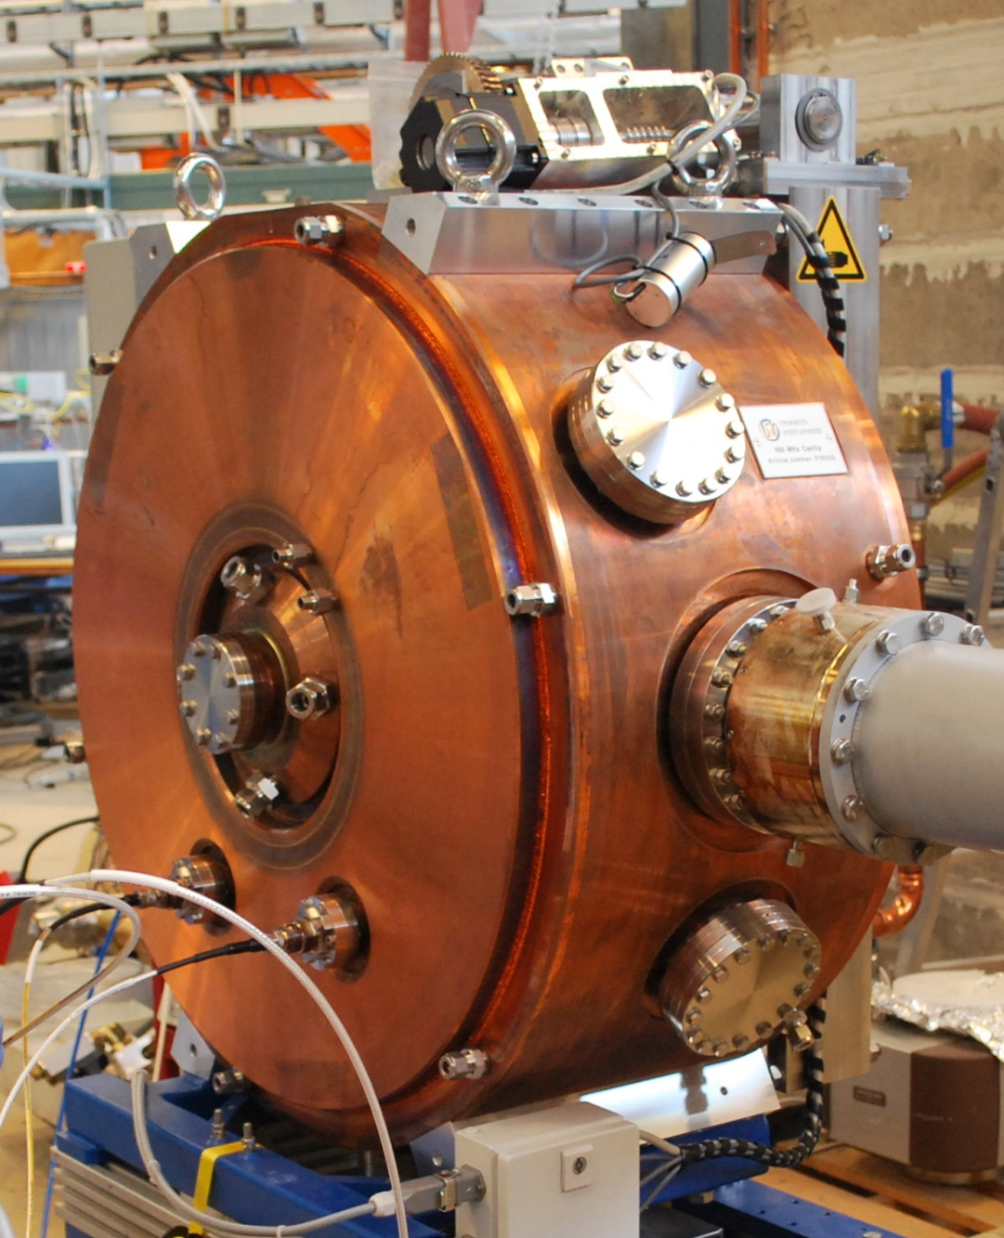
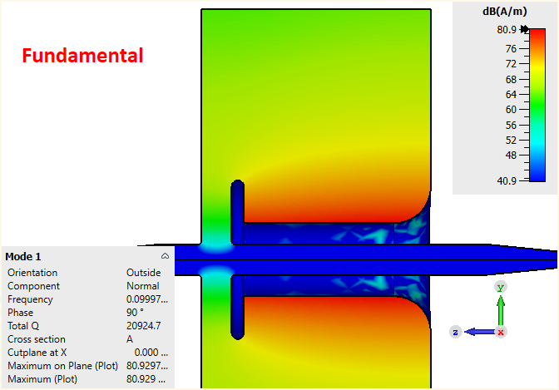
100 MHz RF Cavity
E-field (dB)
Deformable
endplate
Tuning mechanism Available ports
Beam
(b)
Normal H-field (dB)
Deformable
endplate
Beam
Photos from: Jonas Björklund Svensson, ”Characterization of Higher Order Modes in the MAX IV Active 100 MHz Cavities”
Notes:
Concept employed at MAXLAB
Capacitively loaded, deformable endplate
Fundamental coupler, HOM damper ports, LLRF ports
Fundamental mode, low E-field regions high H-field regions and axissymmetry

Slide 7
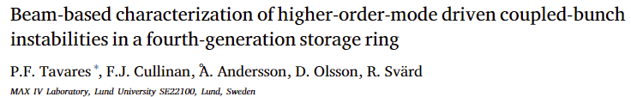
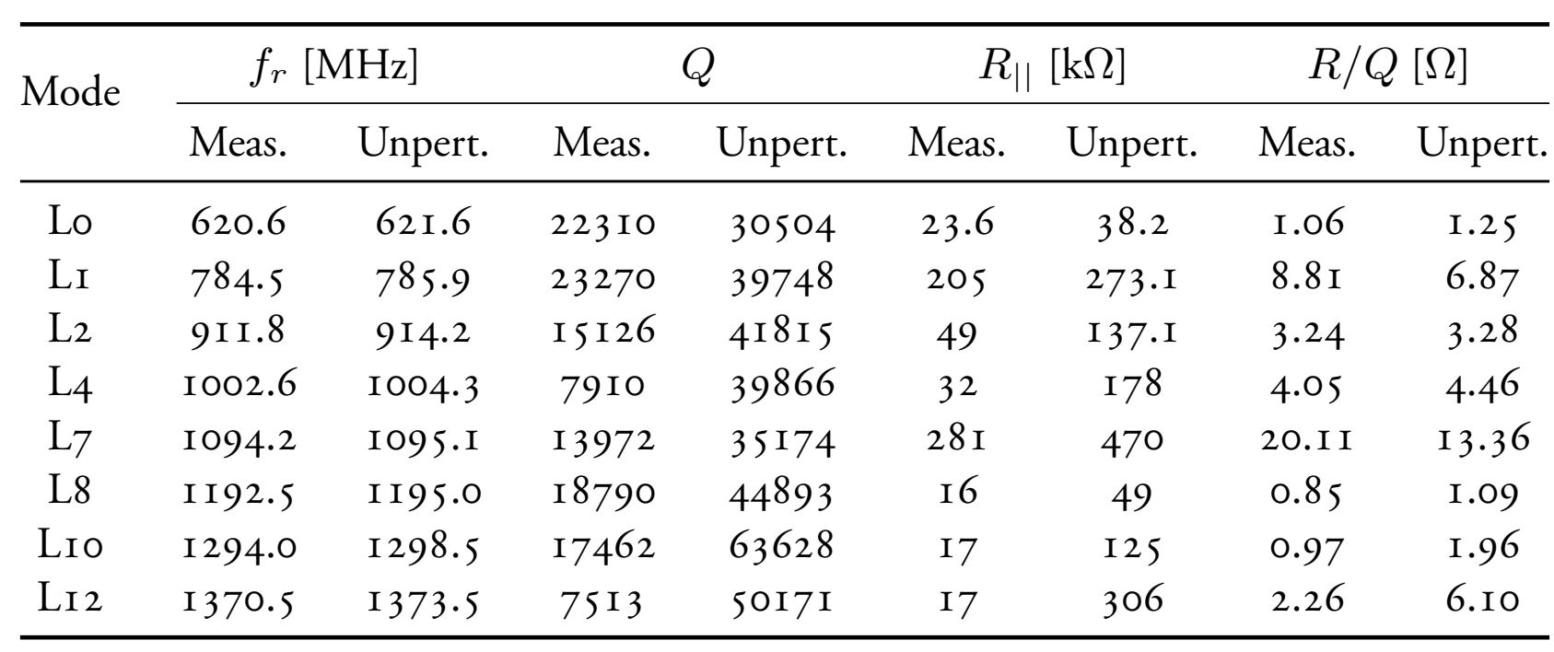
+ Unperturbed axisymmetric simulations
Notes:
Comparing R/Q
Strongest HOMs

Slide 8
Guidelines
Damping guidelines:
  All modes but L7 damped below 3 kΩ shunt impedance
  Leave L7 undamped
Design guidelines:
  Compact
  Simple to manufacture
  Use off-the-shelf components for the complex parts
  Provide cooling solution (no welding between water and vacuum media)

Slide 9
EM Design

Slide 10
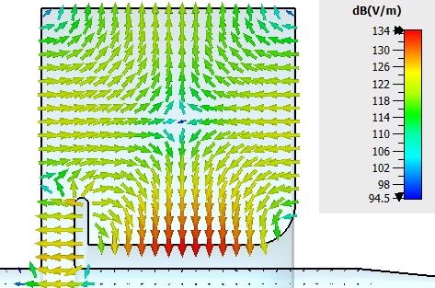
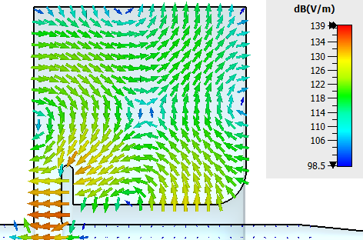
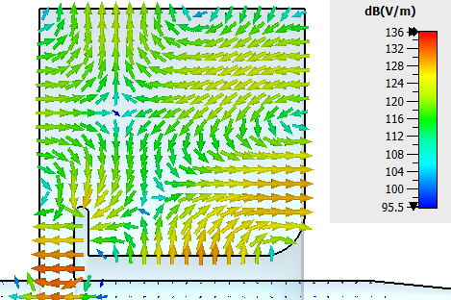
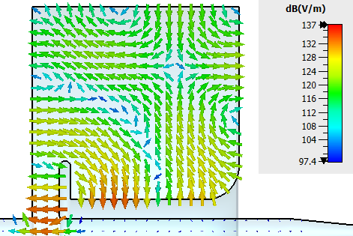
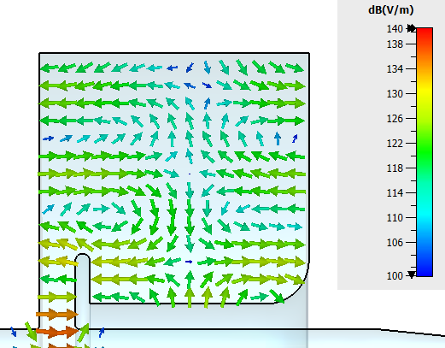
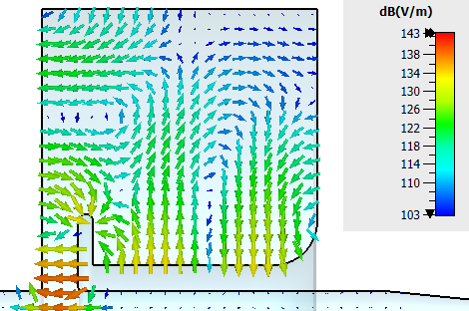
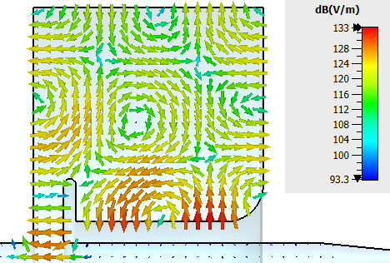
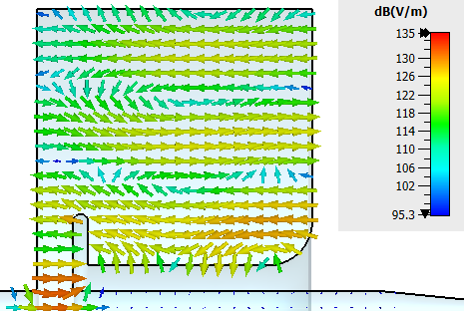
Axisym. E-field distributions for the HOMs
Position 1
Position 2
Position 1
Position 2
Position 1
Position 2
Position 1
Position 2
Pos. 3
Pos. 3
Pos. 3
Pos. 3
L0
L1
L2
L4
Position 1
Position 2
Position 1
Position 2
Position 1
Position 2
Position 1
Position 2
Pos. 3
Pos. 3
Pos. 3
Pos. 3
L7
L8
L10
L12

Slide 11
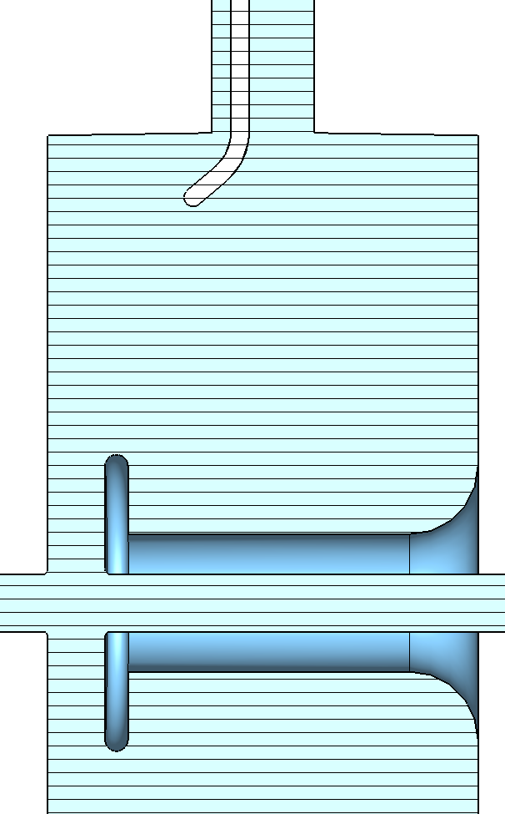
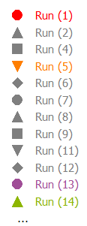
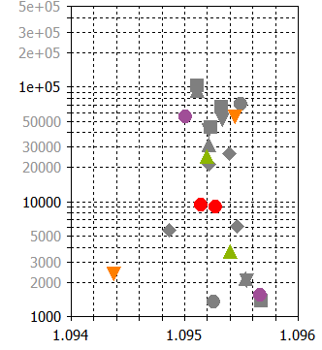
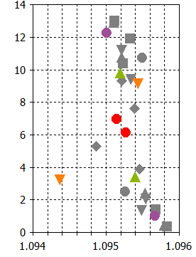
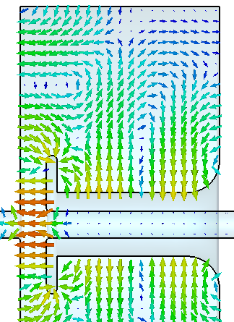
L7 Degenerate Twins Example: J-probe
Long. Shunt Impedance
Unperturbed
Long. R over Q
*
*
*
*
R|| [Ω]
R|| / Q [Ω]
Goal
Frequency [GHz]
Frequency [GHz]

Slide 12
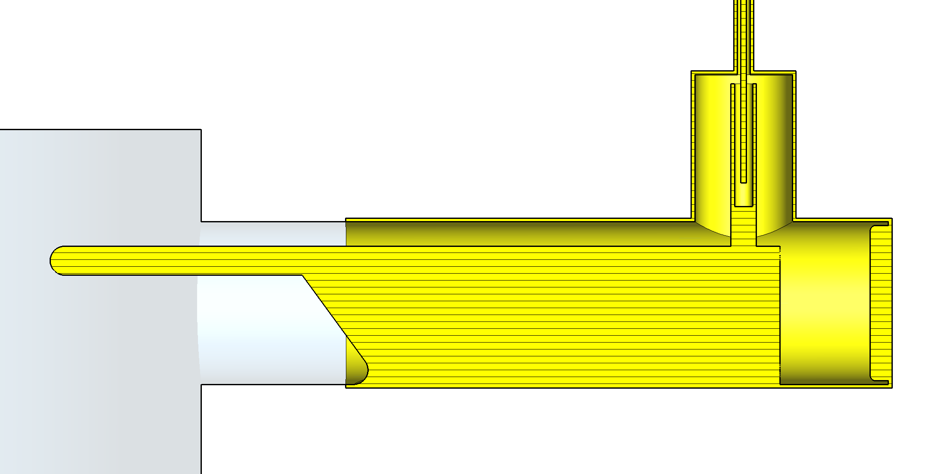
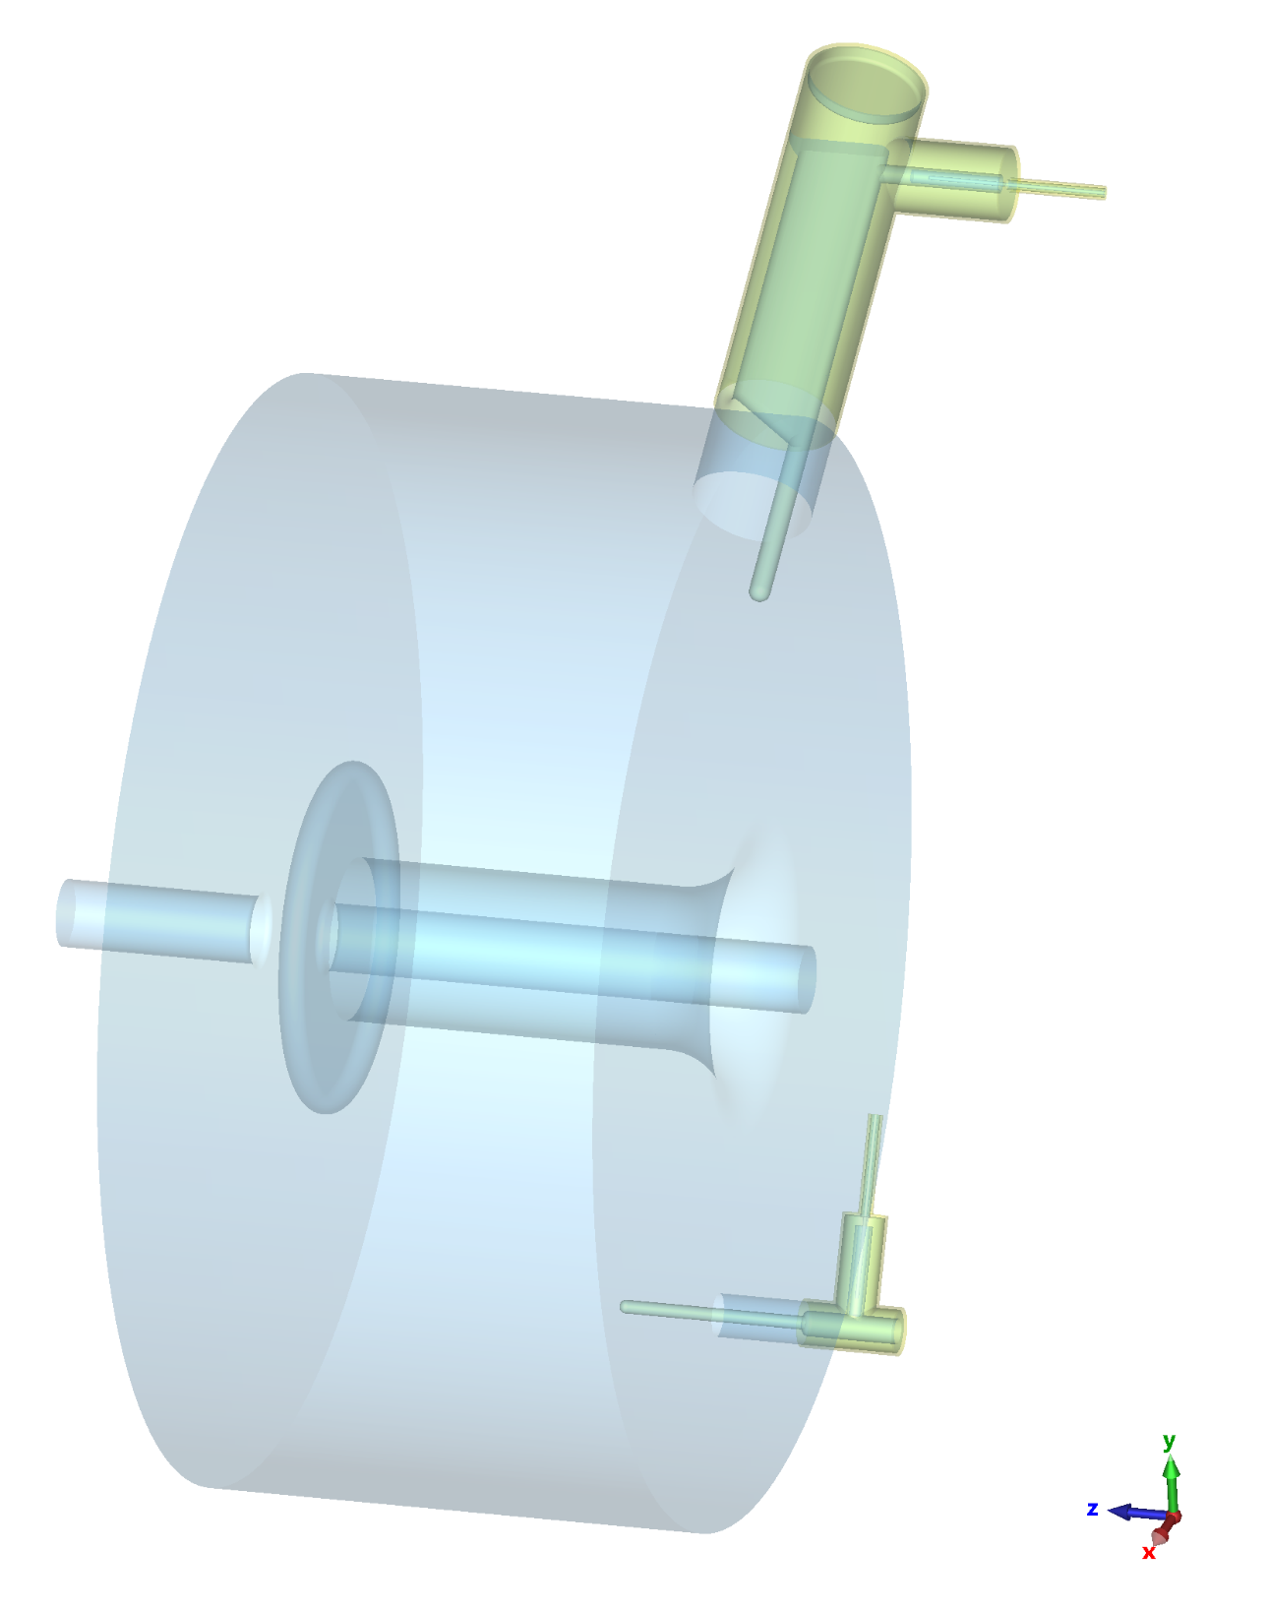
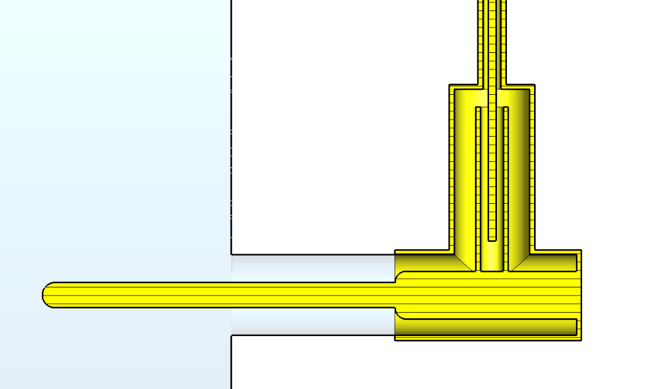
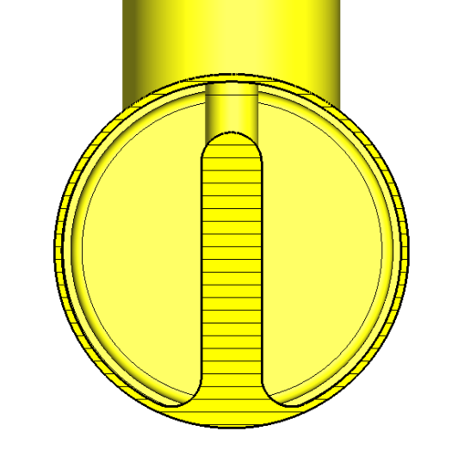
All-but-L7 HOM Dampers (Pos. 2 and 3)
75 dB fundamental power rejection

Slide 13
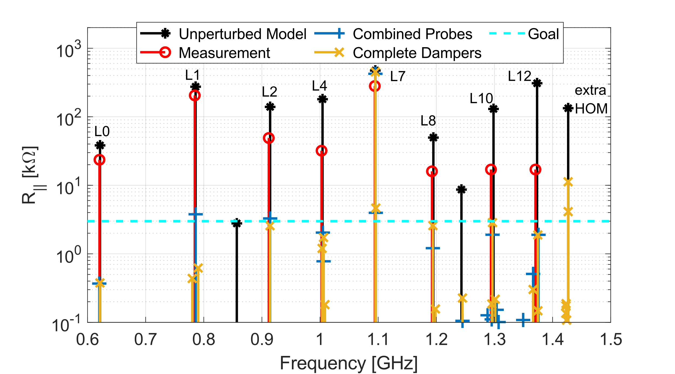
All-but-L7 Dampers: Complete Model

Slide 14
Studies Performed
Wakefield vs. Eigenmode solvers benchmark
Sensitivity analysis
  Mechanical tolerance for cavity radius (min, max and nominal)
  Parked and Tuned (99.63 MHz and 99.93 MHz) conditions
  20 °C and 90 °C cavity temperature
Power deposition (fundamental + HOMs) and thermal simulations
Detailed model, HOMs coupling to the transmission line (next slide)

Slide 15
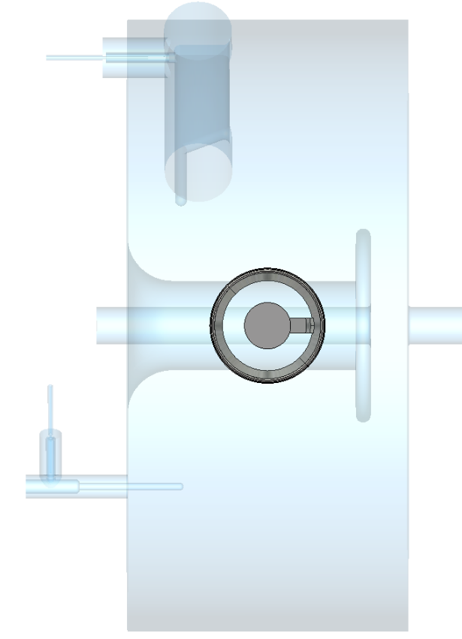
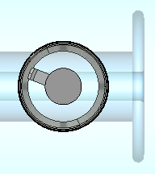
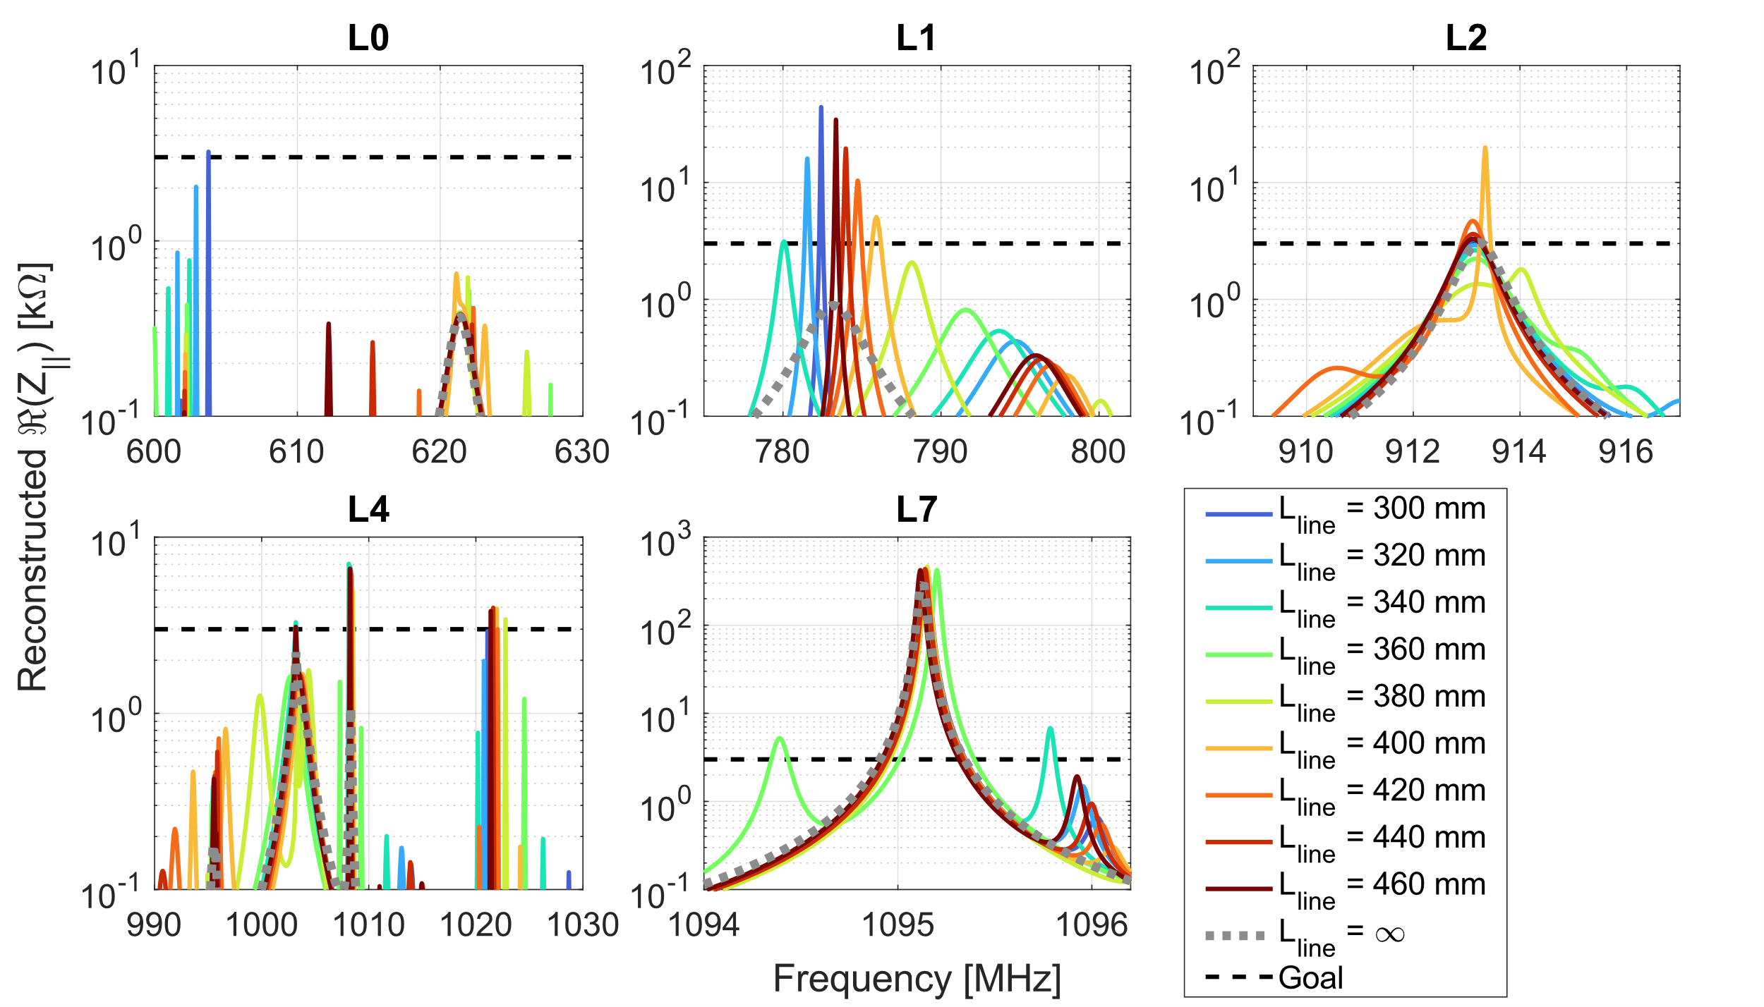
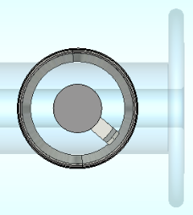
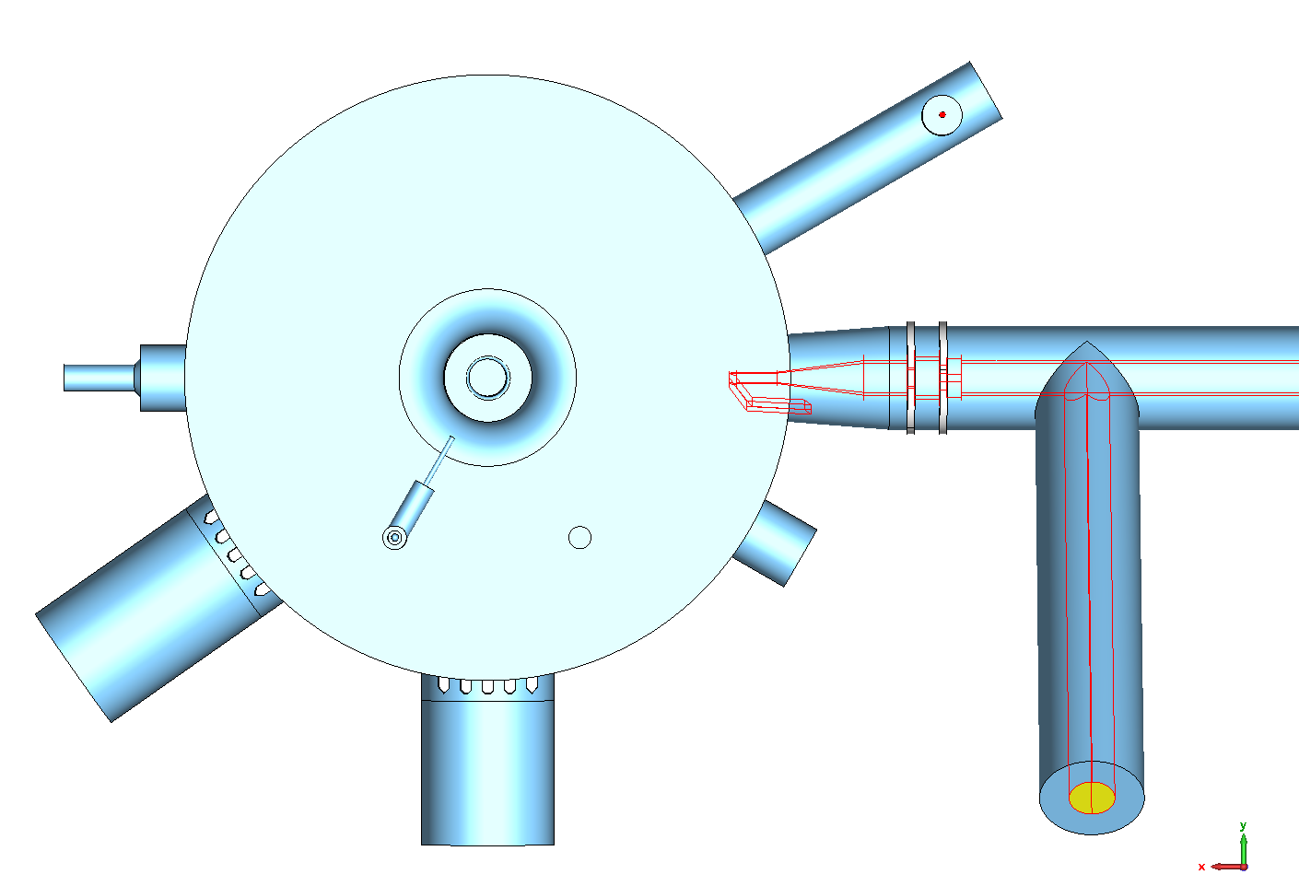
Detailed Cav. Model: Line Length
158°
0°
-40°
Position 2
damper
line
Extra coupler port
coupler
LLRF
port
Position 3
damper
Position 1
Port
stub
Pump station
grids

Slide 16
Cold RF Measurements

Slide 17
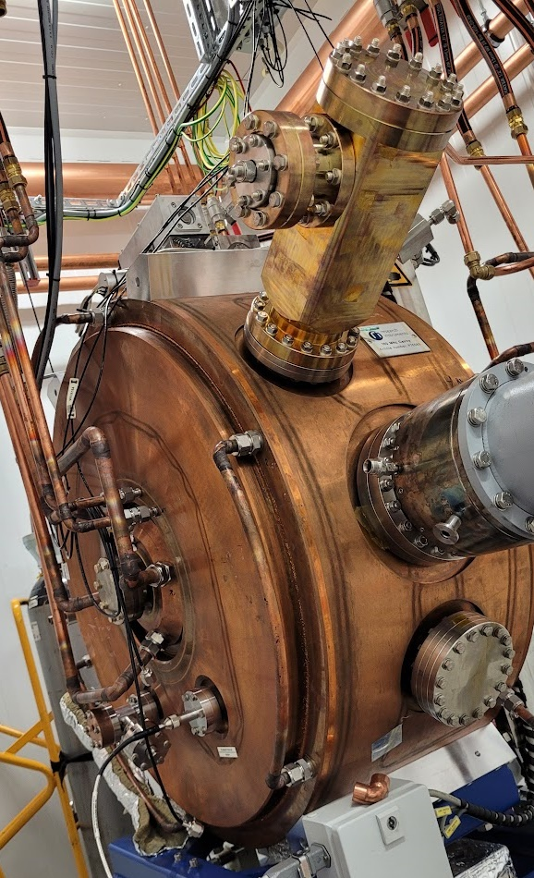
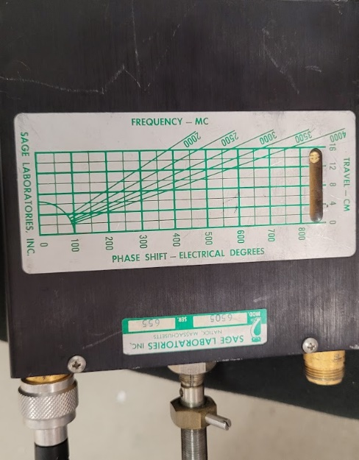
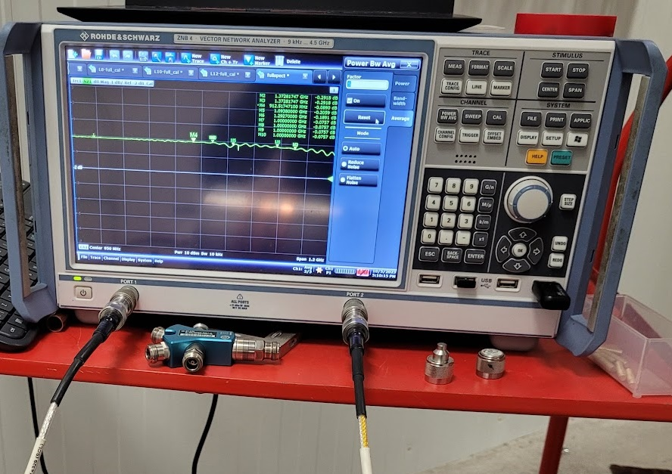
Measurement Setup
Phase shifter
Pos. 2 Damper
Beam port
antenna
Pos. 1
Damper
LLRF pick-up
loop

Slide 18
Phase Shifter (PS) Sweep: L0 to L4
Simulation (eq. 25 °C)
Measurement (45 °C)

Slide 19
Phase Shifter (PS) Sweep: L7 to L12
Simulation (eq. 25 °C)
Measurement (45 °C)

Slide 20
Without vs. With HOM Dampers
TL
L1
L2
L4
L7
L8
L10
L12
L0
- Circ. TL
TL

Slide 21
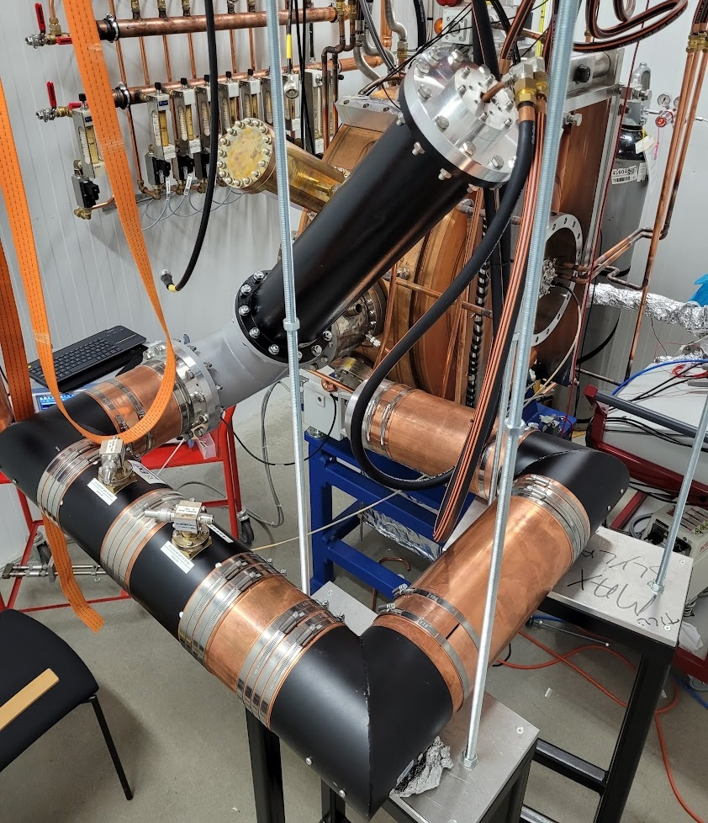
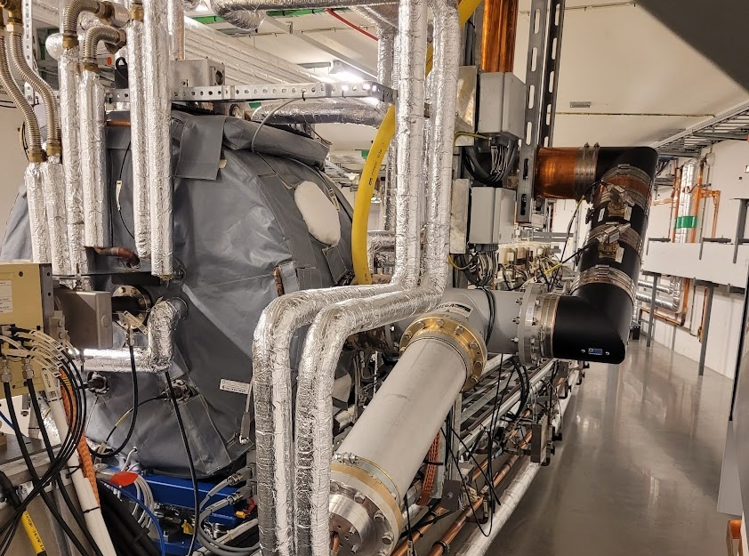
Measurements: Other Studies Performed
Parked vs Tuned (99.63 MHz and 99.93 MHz)
Temperature (25 °C and 45 °C)
U-piece
  5-12 cm
  elongation
Transmission line
with circulator
Tunnel
RF Lab

Slide 22
Conclusion

Slide 23
Final Remarks
We have designed and built probe-type HOM dampers for the MAX IV 100 MHz cavities
  They can damp the HOMs by large factors (10-200)
  One mode, L7, is left unaffected so it can be dealt with by temperature tuning
  The effect of the transmission line connected to the cavity is very important to define the damper performance
The prototypes will begin RF conditioning next week
The cavity with the HOM dampers is scheduled to be installed during the winter shutdown
  U-piece dimension tested on site
Limitations in the ‘with vs. without’ HOM dampers comparison
  R/Q of some modes change considerably
  Bead-pull and stretched-wire methods are too invasive (vacuum wise)
  Beam-based measurement for the final quantification

Slide 24
Thank you!

Slide 25
Backup Slides

Slide 26
Mechanical and Thermal Aspects

Slide 27
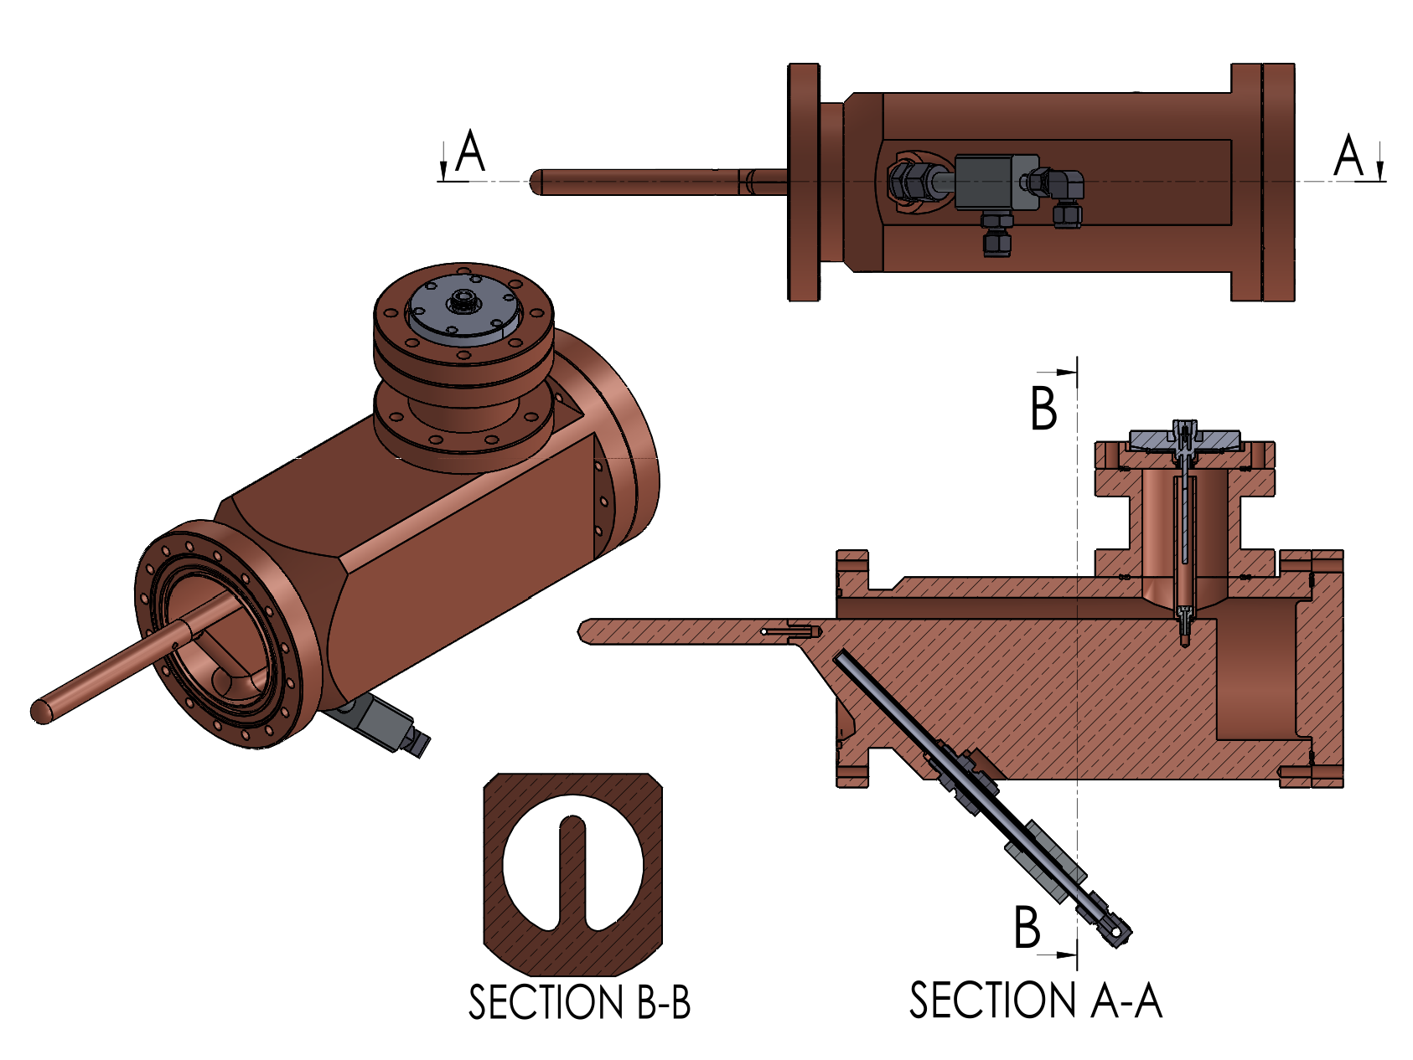
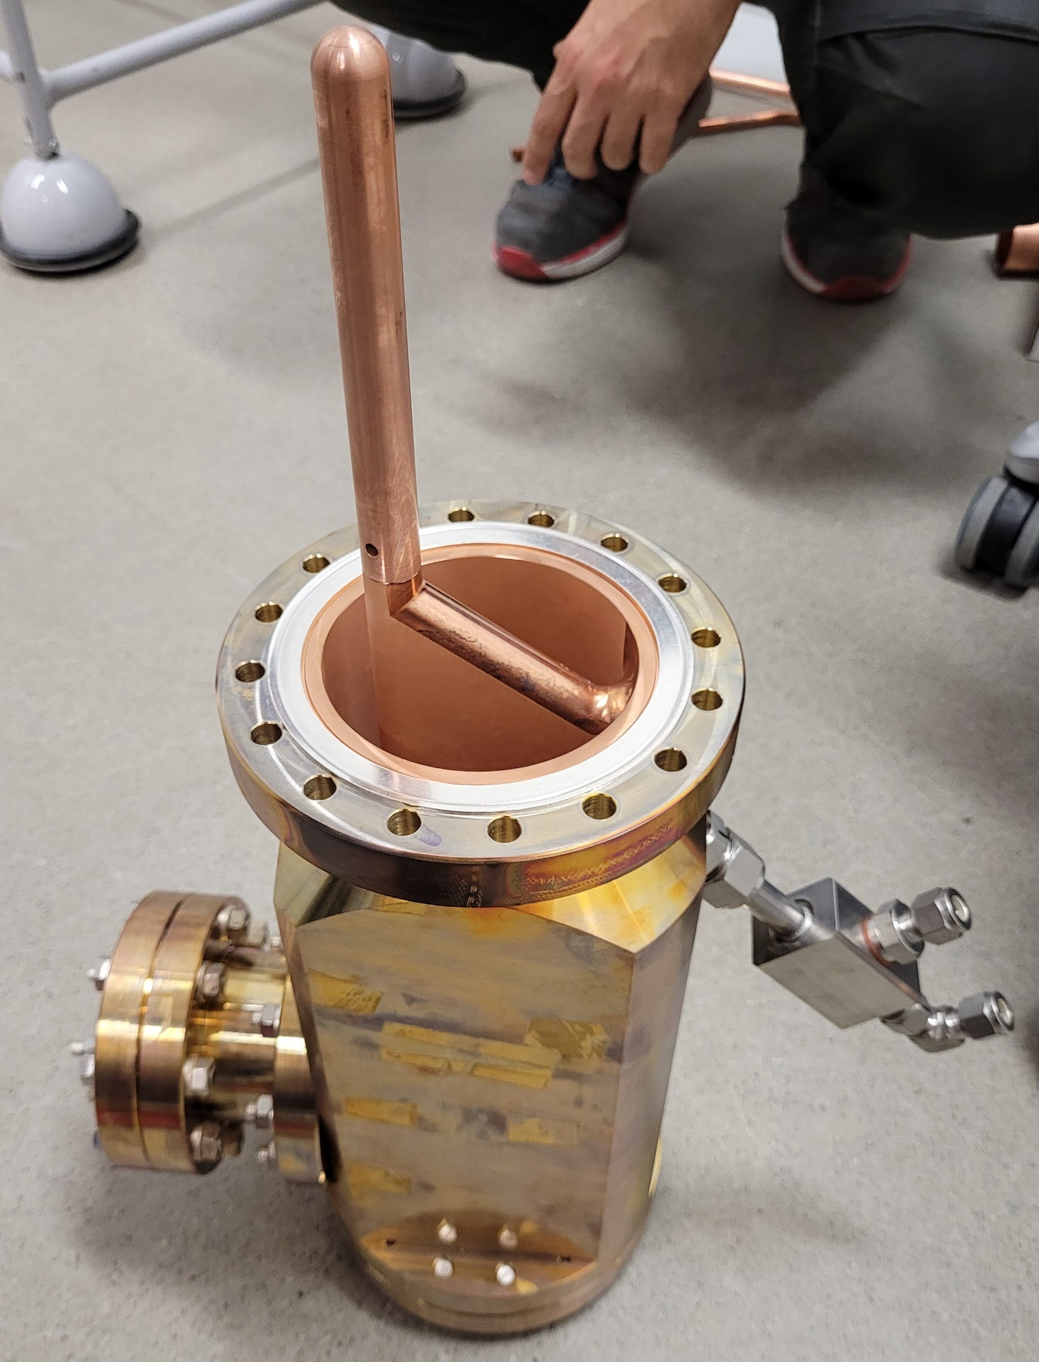
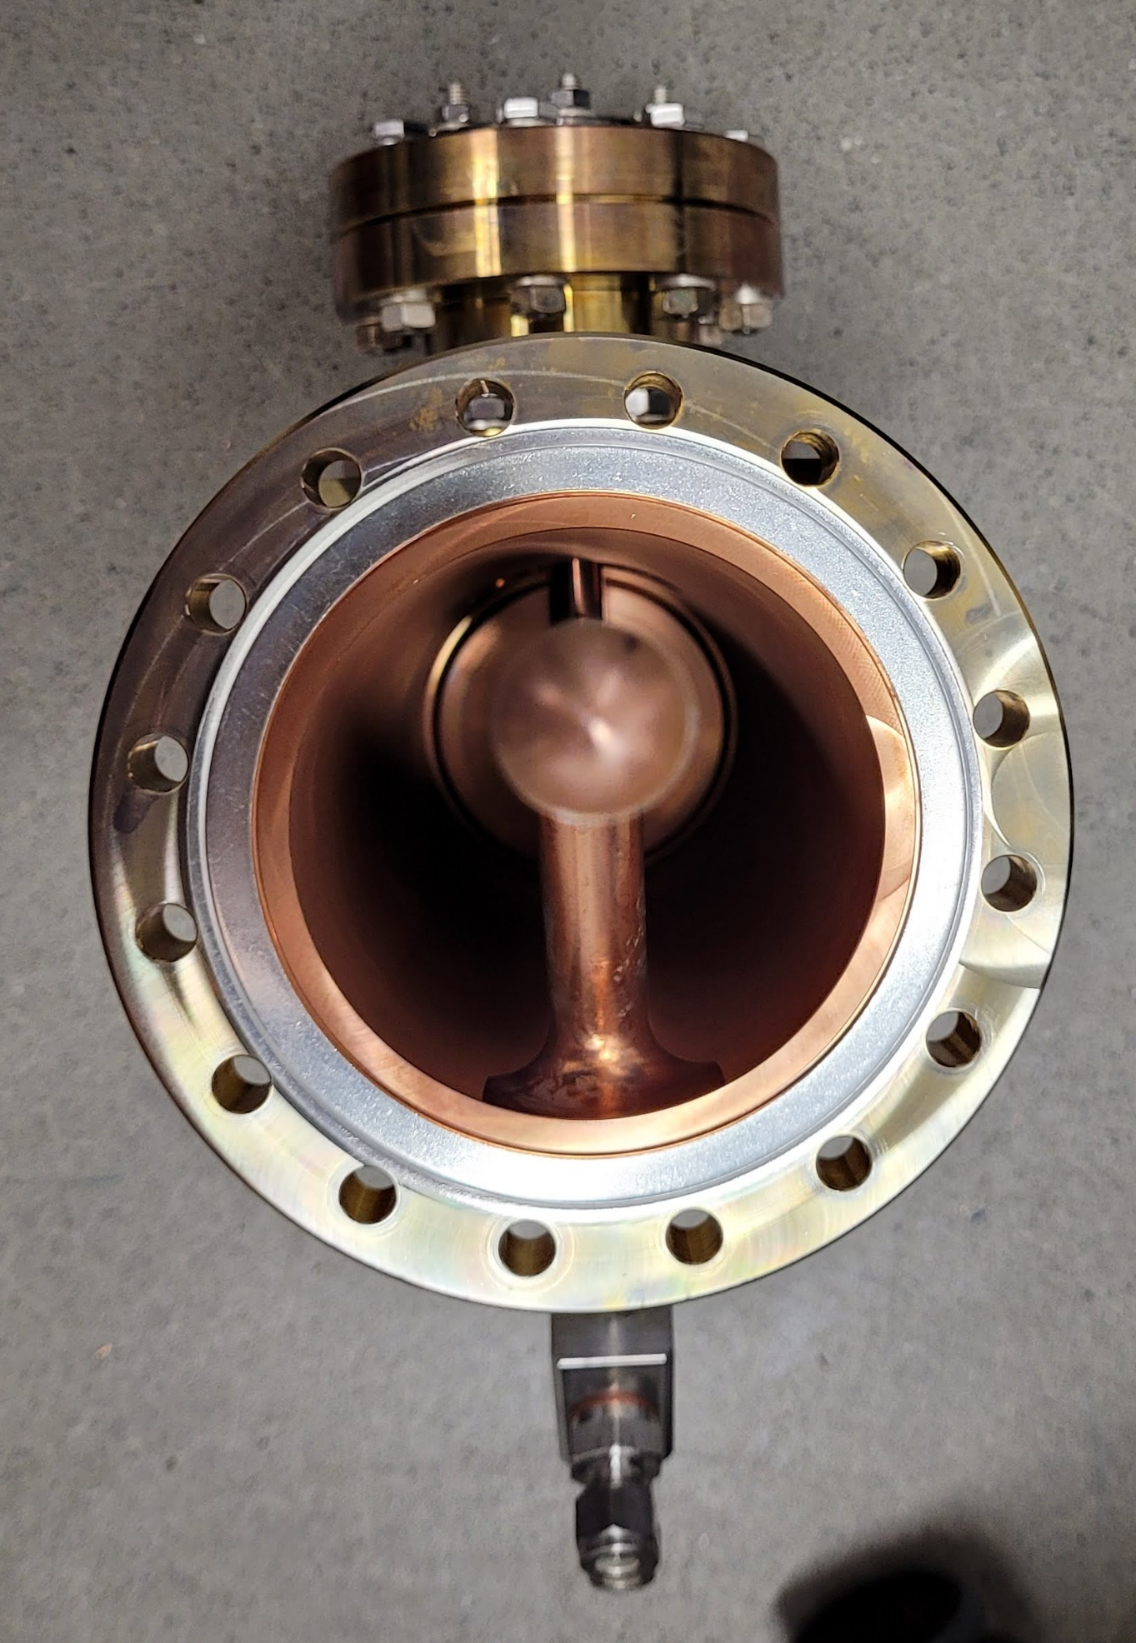
Mechanical Design: Position 2 Damper
Courtesy of
Karl Åhnberg and Mohammad
Al-Najdawi

Slide 28
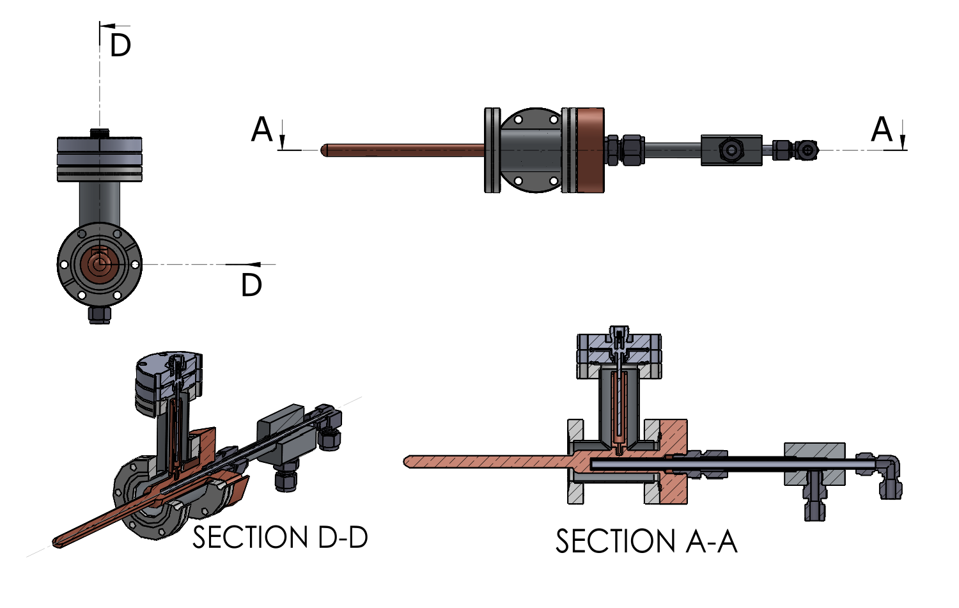
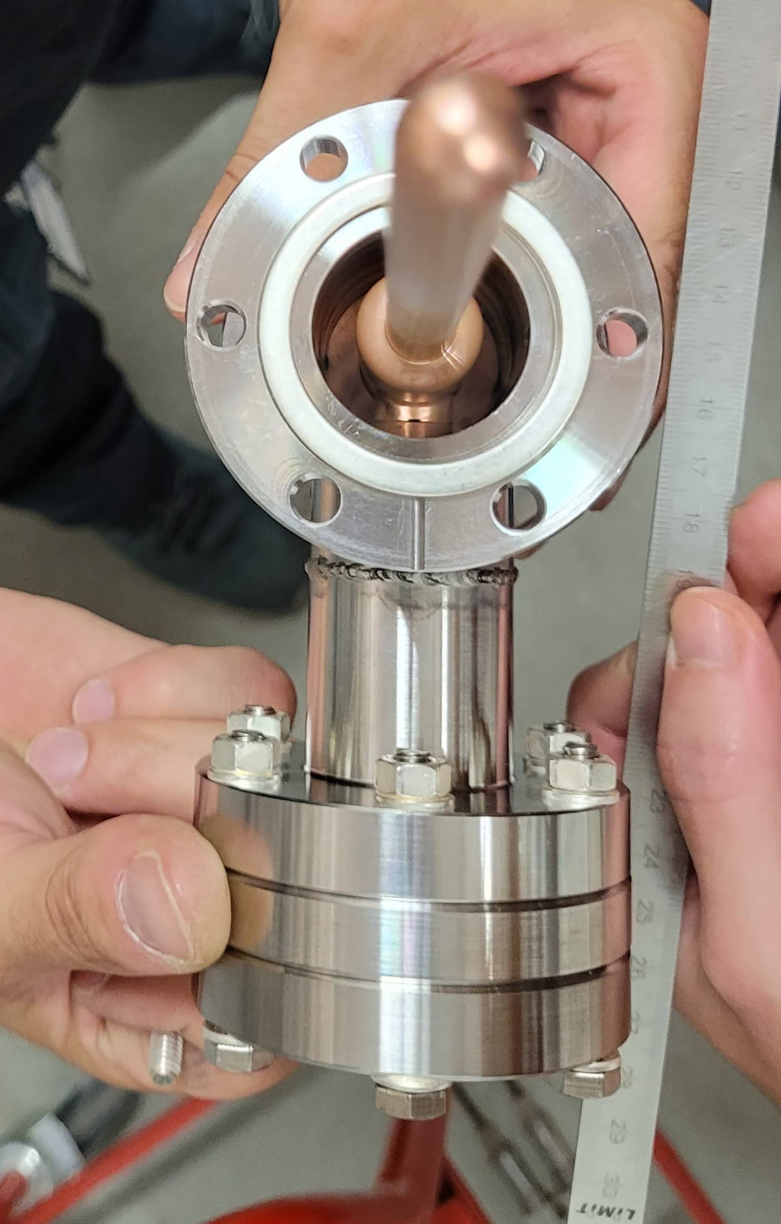
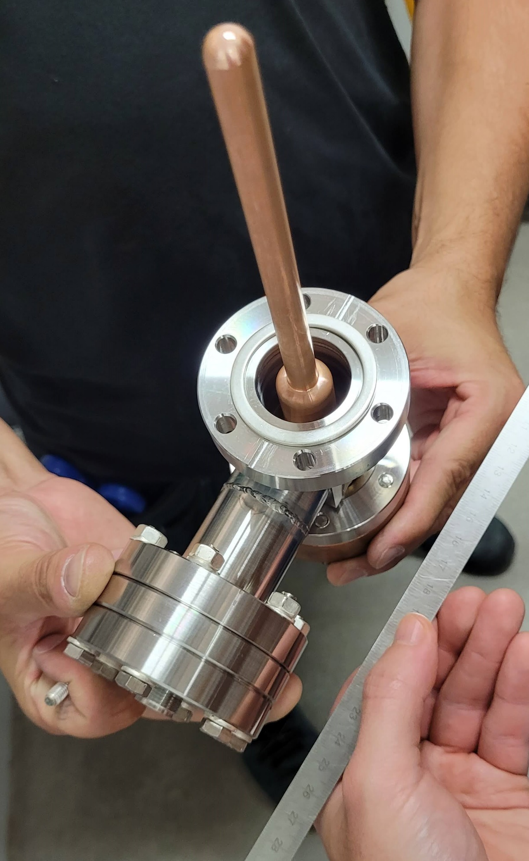
Mechanical Design: Position 3 Damper
Courtesy of
Karl Åhnberg and Mohammad
Al-Najdawi

Slide 29
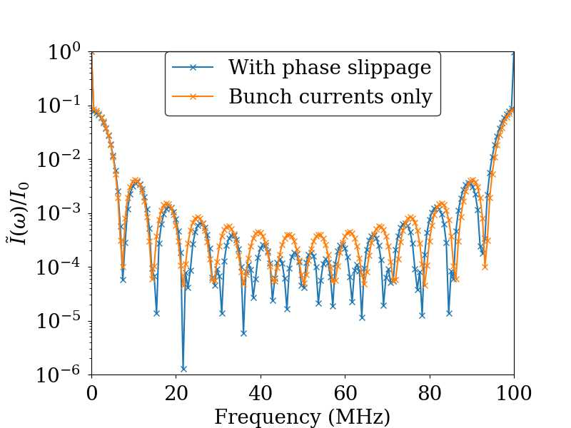
Thermal Simulation Inputs
Heat Load Considerations
  I₀ = 500 mA
  No bunch roll-off in frequency
  HOM freq. shifted to the nearest rev. harmonic
  Uneven fill
Thermal Simulation BCs:
  convection to air at 24 ◦C
  and h = 5 W/m2 ·◦ C
  convection to water at 70 ◦C and
  h = 1 · 10⁴ W/m2 · ◦C
  radiation at 25 ◦C and emissivity of 0.2
    Probe
    Inside the series stub
Considered distribution
Courtesy of Francis Cullinan

Slide 30
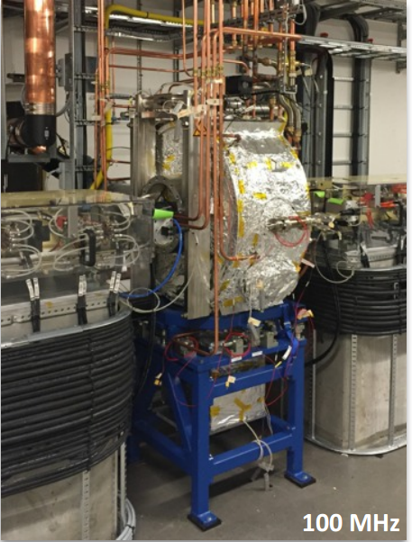
MAX IV Main Cavity
Å. Andersson
 | Main cavities
Type | Capacity Loaded, Normal Conducting
Frequency tuning | Elastic one-side deformation
HOM dampers | Ports available, not used (yet)
For 3 GeV ring:
Max voltage/cavity | 300 kV
Max wall loss/cavity | 27 kW
Max power to beam/cav | 500 kW/6 = 83 kW
Optimum coupling | 4.1
*6
Facilities using such cavity type:
SOLARIS (Poland)
SLRI (Thailand)
ASTRID (Denmark)
ILSF (Iran)

Slide 31
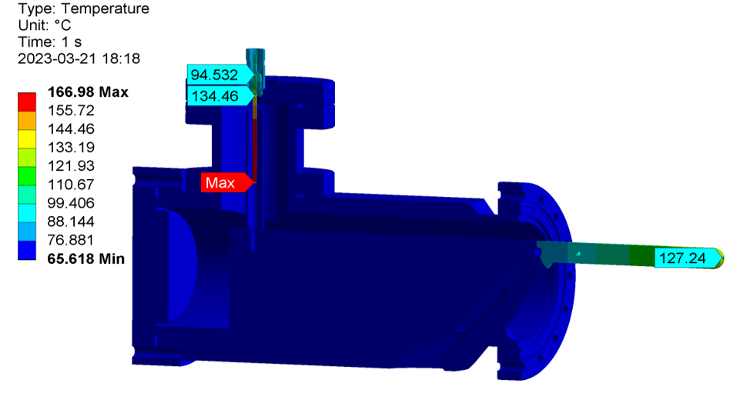
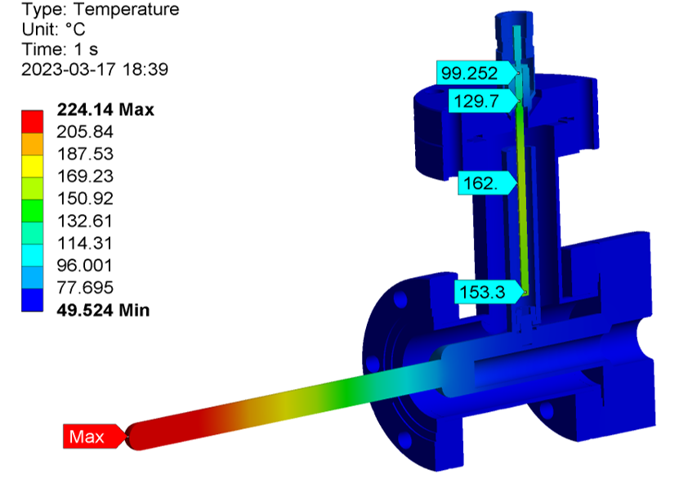
Thermal Simulation Results
P_{fund} = 28 W; P_{HOM} = 0.72 W (pin) + 0.53 W (cer.)
L1 (40.9%), L10 (28.7%), L4 (17.5%)
P_{fund} = 35 W; P_{HOM} = 1.6 W (pin) + 1.23 W (cer.)
L4 (82.7%), L12 (10.8%), L10 (4.8%)
Courtesy of Karl Åhnberg and Mohammad Al-Najdawi

Slide 32
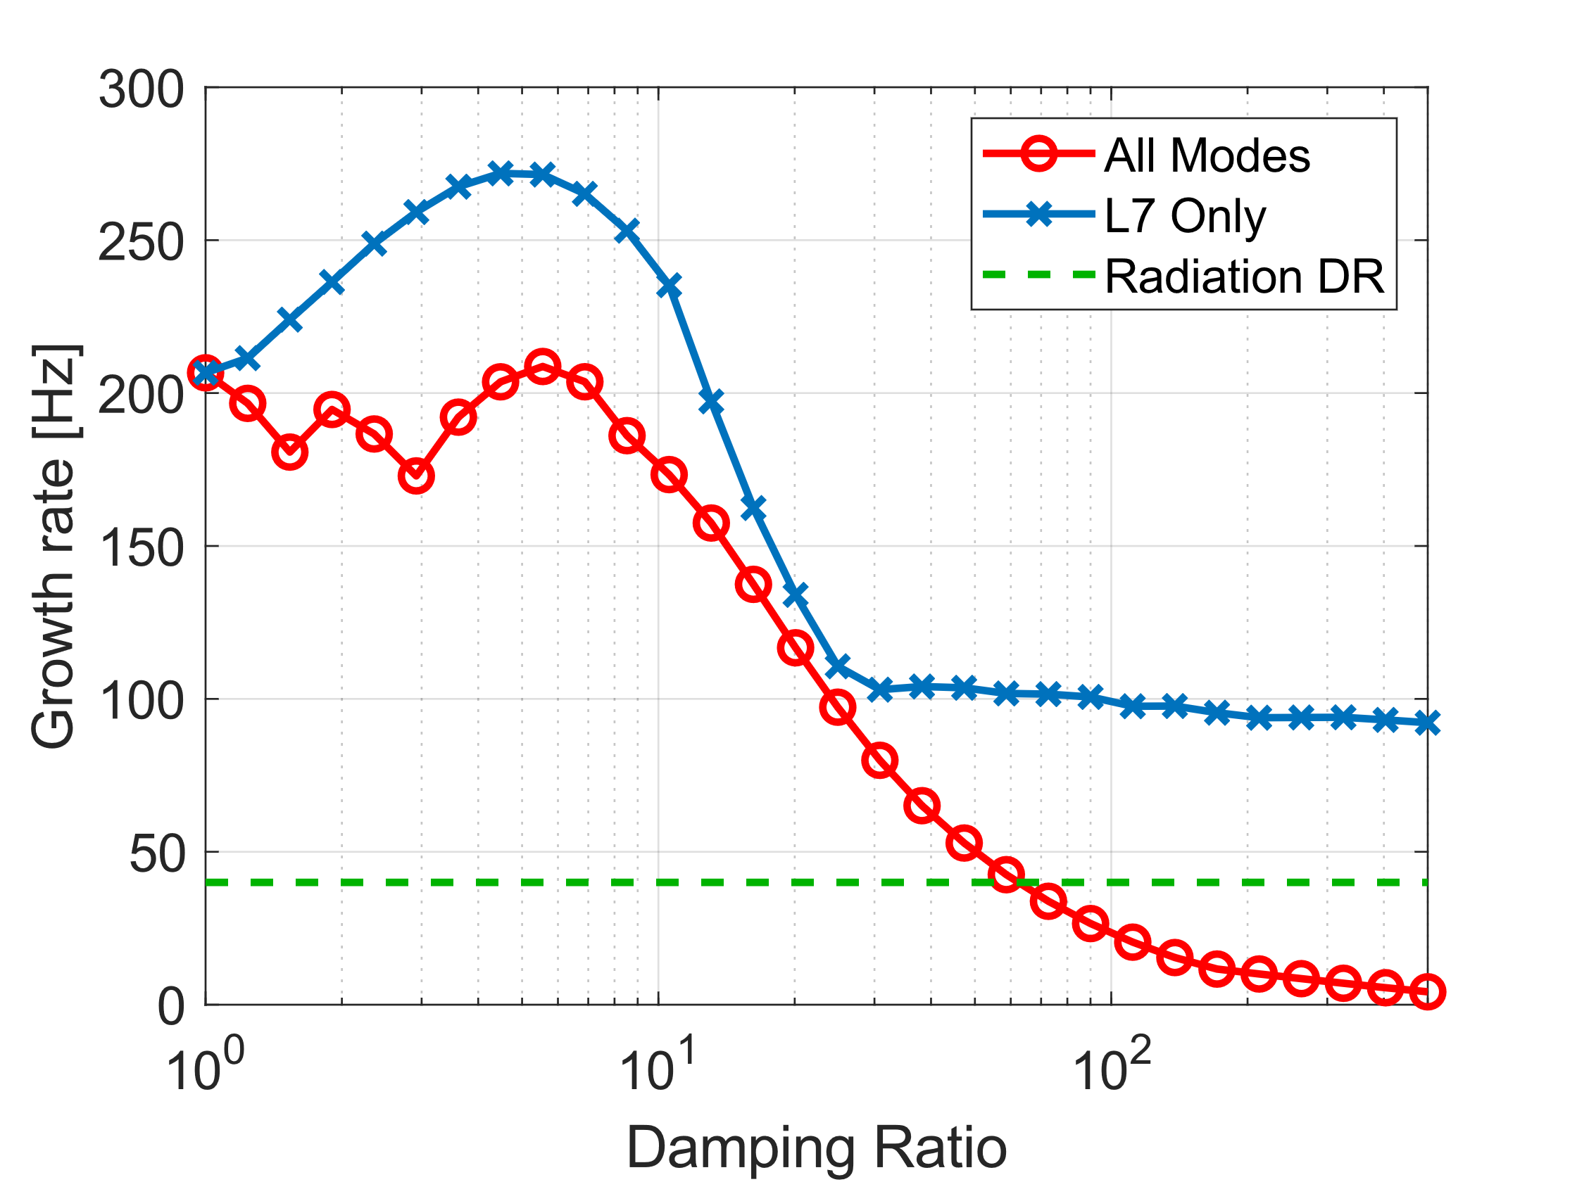
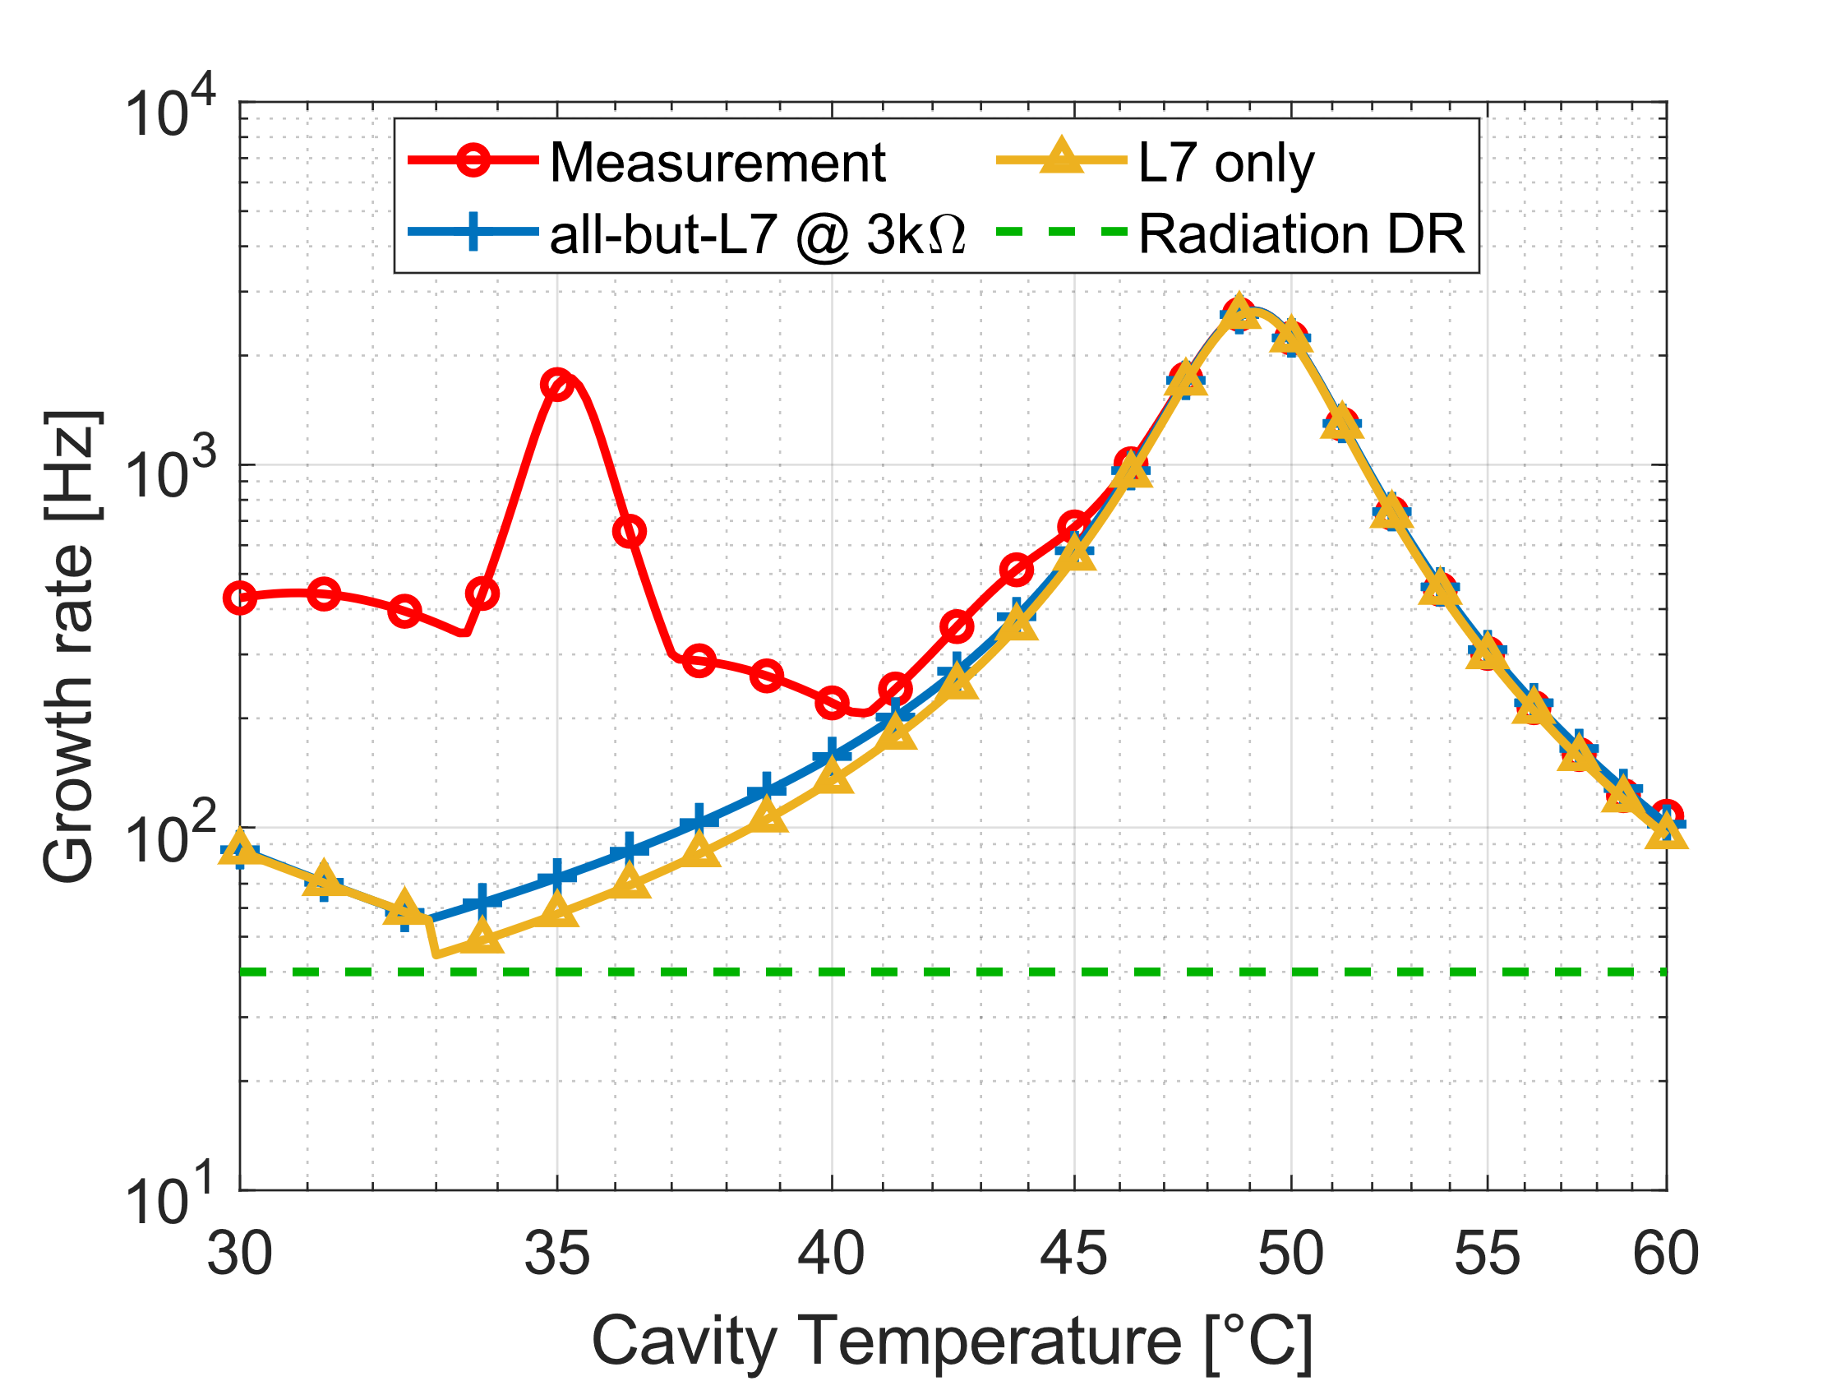
Damping Guidelines
(optimum cav. temperature for each point)
Notes:
HOM model, cav 20, 500 mA

Slide 33
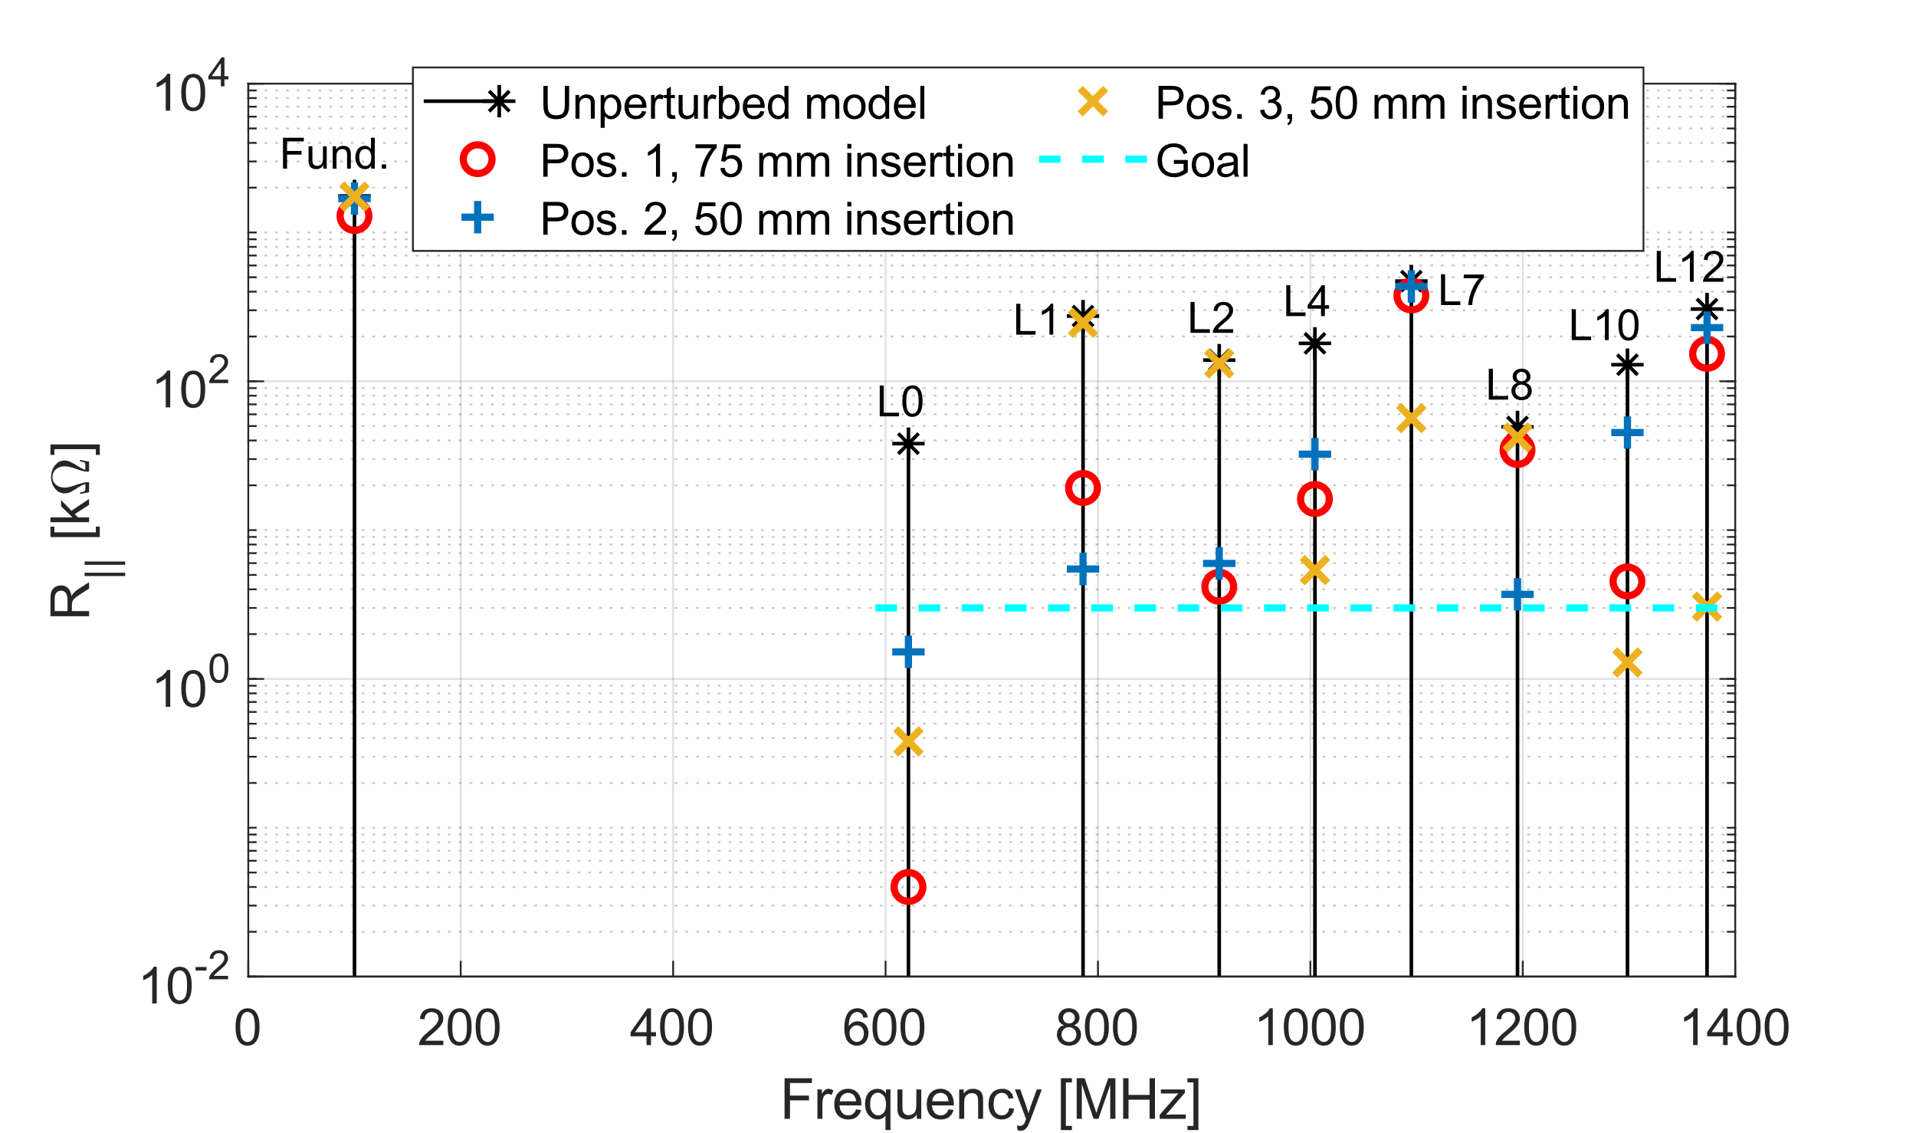
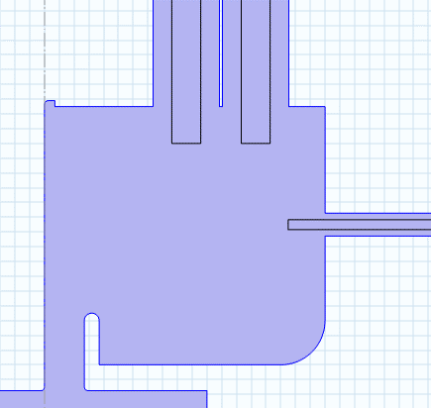
Rod Probes to 50 Ω Lines
Pos. 1
Pos. 2
Pos. 3
Courtesy of David Olsson

Slide 34
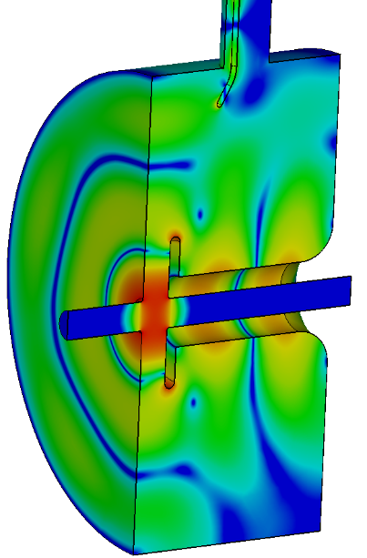
















L7 Degenerate Twins Example: J-probe
1 |  | 2 |  | ← Twin # → | 1 |  | 2
0 | 90 | 0 | 90 | ← Phase (º) → | 0 | 90 | 0 | 90
Run 1
Run 13
E-field Magnitude
Run 5
Run 14
Notes:
Conclusion: leave L7 unattended

Slide 35

Wakefield vs. Eigenmode Solvers Benchmark

Slide 36

Sensitivity Analysis

Slide 37





Extraction Circuits Ideas
KEK
D. Olsson, MAX IV
CERN
KEK

Slide 38




All-but-L7 HOM Dampers: Endplate
Current Design
75 dB fundamental power rejection
(~9.5 W for 30 kW)
50 dB fundamental power rejection
(~95 W for 30 kW)

Slide 39




All-but-L7 HOM Dampers: Mantel
Current Design

